Slide 1
Climate change and the Climate Change Act
MP tools and guidelines training workshop
Day 3
2 September 2026

Slide 2
1
Objectives of today’s workshop

Slide 3
Warmup exercise

Slide 4
Today’s activities
Climate finance guide
Mainstreaming climate mitigation
Data sources and adaptation
GHG inventory tool

Slide 5
2
Data sources summary and way forward

Slide 6
Data collection recap
Summarised data sources lists will be sent to key coordinators by the end of the week
  These will indicate the datasets that can be sourced first
  Meeting will be set up in 2 weeks to follow up on the progress with data collection and perhaps identify next round of data to be collected
Set up regular meeting times with key contacts for data collection:
  When?
  How often?

Slide 7
3
Continuation of activity data analysis

Slide 8
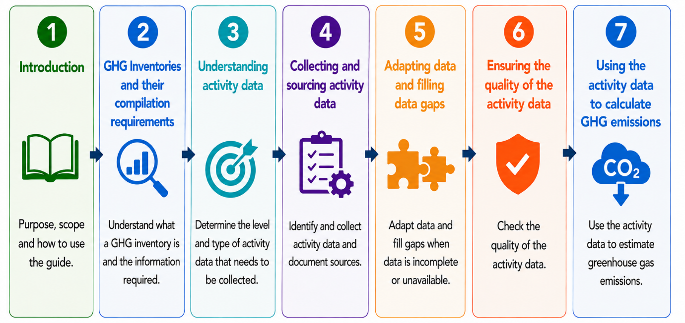
Adapting and filling data gaps
Downscaling
Filling gaps in annual data
Extending a data set from one year to another
Extrapolating data from a small area to total municipal area

Slide 9
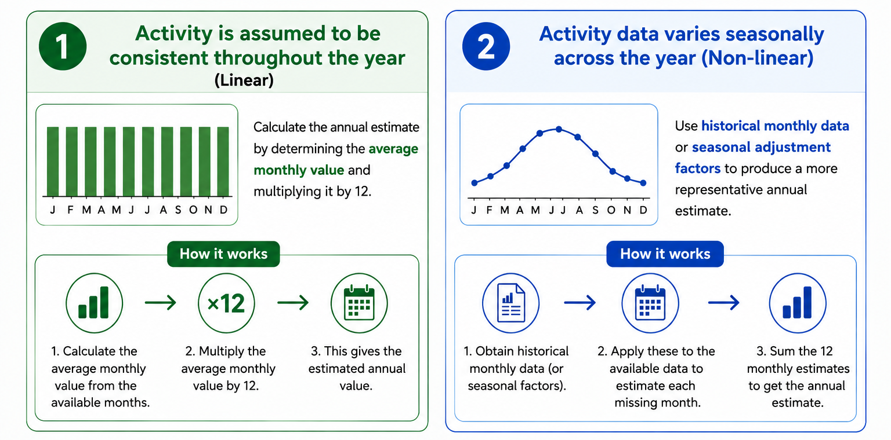
Filling gaps in annual data set
A dataset may not cover the full 12 months
Available data needs to be extrapolated to the full 12 months and this can be done in two ways:
  Activity is assumed to be consistent throughout the year (linear approach).
    In this case the annual estimate can be calculated by determining the average monthly value and multiplying it by 12.
  Activity data varies seasonally across the year (non-linear).
    In these cases, use historical monthly data or seasonal adjustment factors to produce a more representative annual estimate.

Slide 10
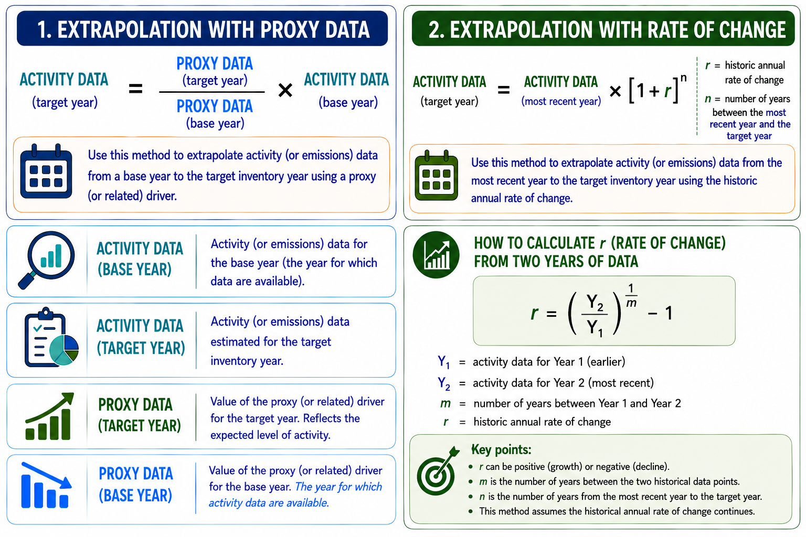
Extrapolating data to another year

Slide 11

Exercise 3

Slide 12
Sectoral break-out group exercise
Look at the package of information and locate Exercise 3 on adapting data
Calculate the activity data for Municipality A for 2025 based on the data provided
40 min

Slide 13
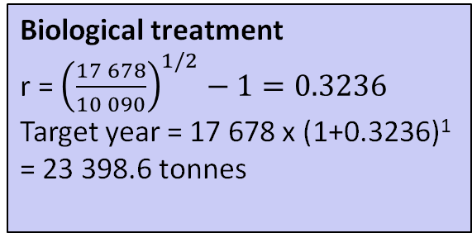
Solution: Waste
Solid waste
Month | Waste generated (tonnes)
January | 29 855
February | 32 444
March | 38 232
Average | 33 510.3
Average x 12 | 402 124
Biological treatment
r = ${\left(\frac{17 678}{10 090}\right)}^{1/2}−1=0.3236$
Target year = 17 678 x (1+0.3236)¹
= 23 398.6 tonnes
Incineration
92 x 2 = 184 tonnes

Slide 14
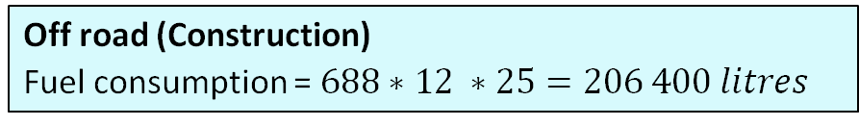
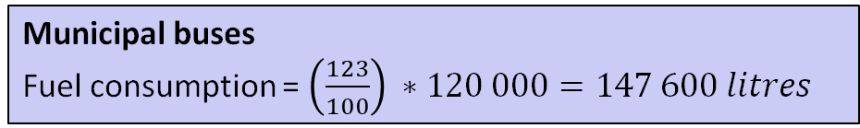
Solution: Transport
Municipal buses
Fuel consumption = ${\left(\frac{123}{100}\right) ∗120 000=147 600 litres}^{}$
Off road (Construction)
Fuel consumption = ${688∗12 ∗25=206 400 litres}^{}$
km travelled
Month | km travelled
January | 1 100
February | 1 350
March | 1 840
April | 980
Average | 1 317.5
Average x 12 | 15 810

Slide 15
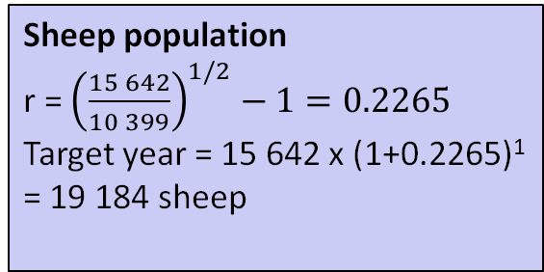
Solution: Agriculture
Sheep population
r = ${\left(\frac{15 642}{10 399}\right)}^{1/2}−1=0.2265$
Target year = 15 642 x (1+0.2265)¹
= 19 184 sheep
Chickens
Average monthly = 250 600 / 5 = 50 120
Annual = 50 120 *12 = 601 440
Horses
8 x 4 = 32 horses

Slide 16
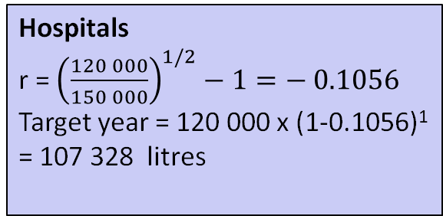
Solution: Energy
Schools
Average monthly = (5+9)/ 2 = 7 MWh
Annual = 7 MWh *12 months * 12 schools = 1 008 MWh
Hospitals
r = ${\left(\frac{120 000}{150 000}\right)}^{1/2}−1=− 0.1056$
Target year = 120 000 x (1-0.1056)¹
= 107 328 litres
Households
11 x 12 x 116 763 = 15,412,716 litres

Slide 17

Downscaling

Slide 18
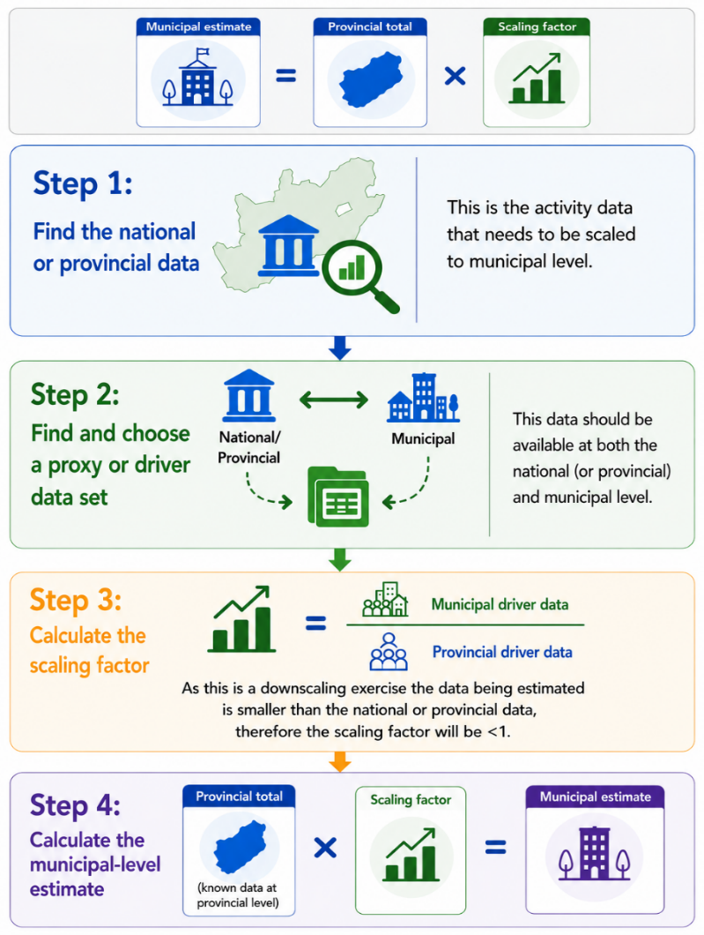
Downscaling data
Downscaling is required for a top-down approach
In this case another related variable (called a proxy or activity driver) is used to estimate the municipal share of the national or provincial data that is available.
Good proxy or driver data should have:
  a relationship with the activity being estimated
  be available at both the national and municipal level and
  be reliable and up to date as far as possible
Driver or proxy data examples:
  Population data
  GDP
  Number of vehicles
  Number of households
  Share of agricultural production
  Production

Slide 19

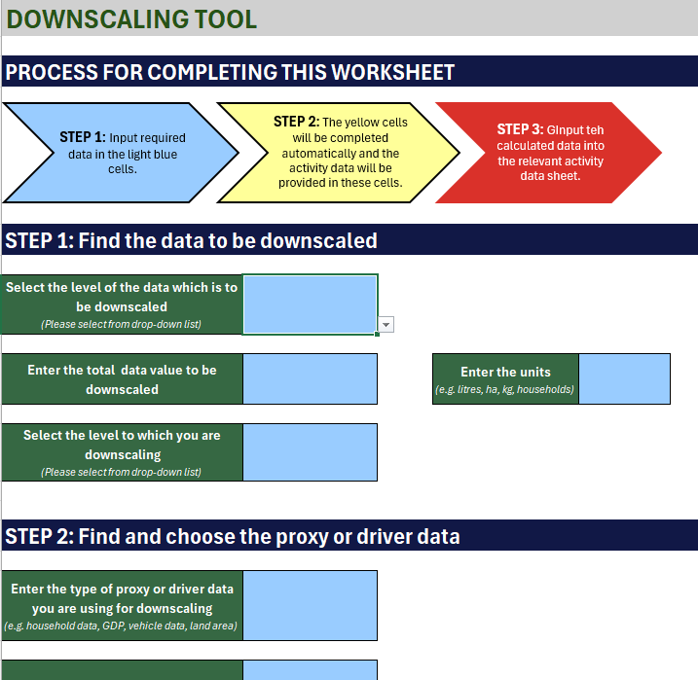
Downscaling

Slide 20
Exercise 4

Slide 21
Sectoral break-out group exercise
Look at the package of information and locate Exercise 4 on downscaling
Complete the table by calculating the activity data for Municipality A
Now lets try using the downscaling tool in the GHG inventory tool
30 min

Slide 22
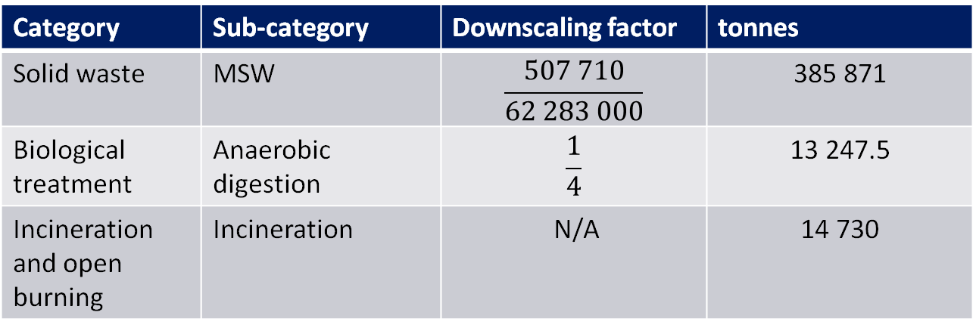
Downscaling Solution: Waste
Category | Sub-category | Downscaling factor | tonnes
Solid waste | MSW | $$\frac{507 710}{62 283 000}$$ | 385 871
Biological treatment | Anaerobic digestion | $$\frac{1}{4}$$ | 13 247.5
Incineration and open burning | Incineration | N/A | 14 730
Open burning
12% * 453 966 = 54 475.9 tonnes

Slide 23
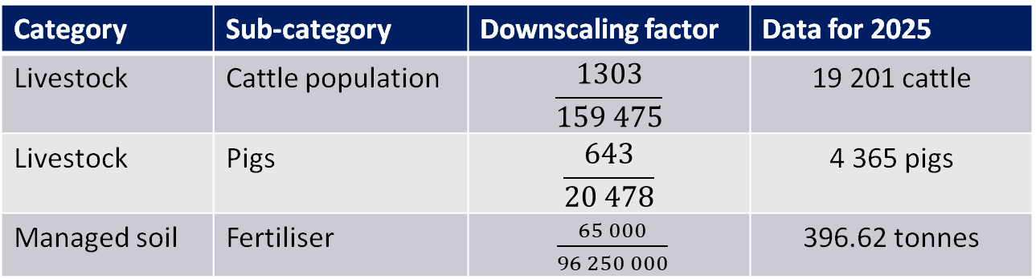
Downscaling Solution: Agriculture
Category | Sub-category | Downscaling factor | Data for 2025
Livestock | Cattle population | $$\frac{1303}{159 475}$$ | 19 201 cattle
Livestock | Pigs | $$\frac{643}{20 478}$$ | 4 365 pigs
Managed soil | Fertiliser | $\frac{65 000}{96 250 000}$ | 396.62 tonnes

Slide 24
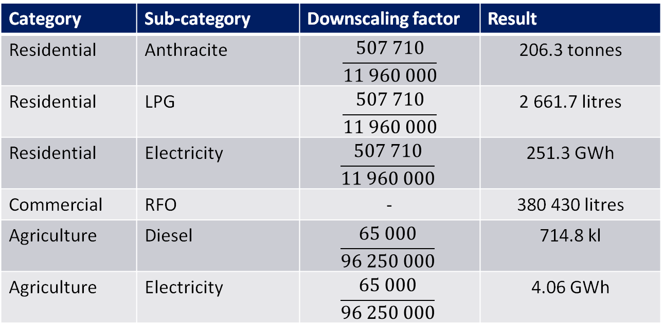
Downscaling Solution: Stationary energy
Category | Sub-category | Downscaling factor | Result
Residential | Anthracite | $$\frac{507 710}{11 960 000}$$ | 206.3 tonnes
Residential | LPG | $$\frac{507 710}{11 960 000}$$ | 2 661.7 litres
Residential | Electricity | $$\frac{507 710}{11 960 000}$$ | 251.3 GWh
Commercial | RFO | - | 380 430 litres
Agriculture | Diesel | $$\frac{65 000}{96 250 000}$$ | 714.8 kl
Agriculture | Electricity | $$\frac{65 000}{96 250 000}$$ | 4.06 GWh

Slide 25
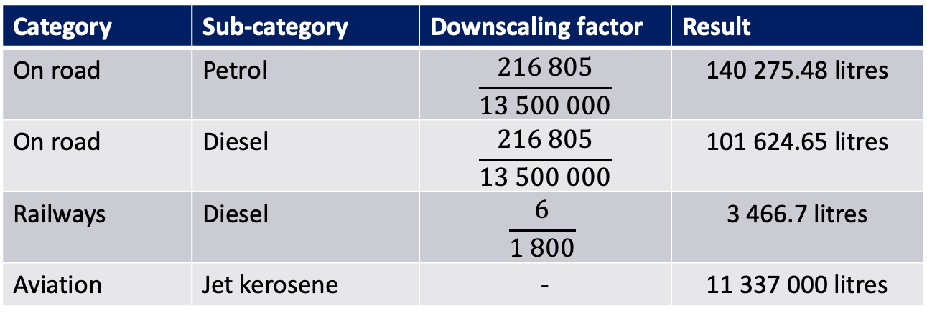
Downscaling Solution: Transport
Category | Sub-category | Downscaling factor | Result
On road | Petrol | $$\frac{216 805}{13 500 000}$$ | 140 275.48 litres
On road | Diesel | $$\frac{216 805}{13 500 000}$$ | 101 624.65 litres
Railways | Diesel | $$\frac{6}{1 800}$$ | 3 466.7 litres
Aviation | Jet kerosene | - | 11 337 000 litres

Slide 26
Ensuring the quality of the activity data
Guiding principles for quality data collection
Data quality checks

Slide 27
Quality checks

Slide 28

Using activity data to calculate emissions
Guides the user to the GHG inventory tool

Slide 29

4
GHG inventory tool

Slide 30

Go to tool

Slide 31
5
Exercises

Slide 32
Sectoral break-out group exercise
Use the data from Exercise 2 and 4 as input data for this exercise
Look at your data and identify which categories you have data for
Go to the data collection template for your sector
Check what input and units are required
Make any adjustments to your data in preparation for data entry
Try entering the data into the tool
One representative from each group will come to the front and demonstrate to everyone how you entered your data for your sector
Facilitator to discuss the emission outputs
45 min + 30 min

Slide 33
6
Climate finance guide

Slide 34
The role of municipalities in mitigation
Municipalities role is service delivery - electricity supply, water supply, sanitation, waste management, transport, public lighting, and local economic development.
These activities can also be a significant source of greenhouse gas emissions, and designing them properly can limit emissions.
Challenges to service delivery (limited financial resources, a lack of implementation capacity, and uncoordinated planning), can also limit ability to do mitigation action to reduce emissions.
Mitigation can thus turn into another unfunded demand being placed on already overburdened municipalities.
This does not have to be the case.
  Reducing emissions associated with government activities can increase efficiency and positive impacts and reduce costs.
  Significant amounts of climate finance are being mobilised in South Africa and internationally to support mitigation and increase service delivery – thereby contributing to a just transition.

Slide 35
Examples of links between service delivery and mitigation
Improved public transport improves access to jobs and services, reduces traffic congestion, and cuts emissions through reducing private car use.
Water loss reduction programmes lower delivery costs and improve supply availability, while reducing emissions by reducing the energy required for pumping water.
LED streetlights reduce energy costs and frequency of replacement of lighting, can improve safety through better street lighting, and reduce emissions from electricity used for lighting.
Retrofitting energy efficiency options in municipal buildings can save operating costs, while reducing emissions from electricity used for lighting, heating and cooling.
Densification and public transport orientated spatial planning reduces average commute distances, lowers infrastructure servicing costs per capita, and cuts transport-related emissions.

Slide 36
Funding versus financing
Financing: upfront capital used to implement projects
Funding: money that pays for a project over time - ongoing revenue or budget that covers running costs, or the income used to repay a loan or investor.
Ability to generate income from mitigation projects is often constrained for smaller municipalities.
Even if income can be generated, the financial standing or available capacity within many smaller municipalities mean that they will struggle to raise external financing for these projects.
Majority of local government mitigation action in South Africa outside of metros is thus financed from general municipal budgets.

Slide 37
Funding for sub-national mitigation
Type of funding | Description | Examples
Tariffs / user charges | Recurring fees charged to users based on consumption or use of a service. | Electricity, water, sanitation and refuse removal tariffs
Property rates | General property tax levied on property owners, forming part of municipal revenue. | Municipal property rates
Land value capture instruments | Rates and fees linked to the increase in value that accompanies access to municipal services or land use zoning | Betterment fees in areas near new infrastructure Charges linked to increase in commercial property value
Unconditional transfers and grants | Unconditional national transfer to municipalities for free basic services and general operating expenditure. | Local Government Equitable Share (LGES)

Slide 38
Funding for sub-national mitigation
Type of funding | Description | Examples
Conditional grants | Grants to support projects in specific areas or that benefit specific beneficiaries | Municipal Infrastructure Grant Integrated Urban Development Grant Regional Bulk Infrastructure Grant
Development charges / bulk contributions | Once-off charges on new developments to fund the bulk infrastructure. | Engineering services contributions under the Municipal Fiscal Powers and Functions Act
Cross-subsidisation | Surplus generated by a profitable trading service used to subsidise another service. | Electricity trading surplus subsidising other municipal functions
Levies and other municipal revenue | Any municipal revenue that is available to allocate within the municipal budget. | Environmental levies like pollution and congestion charges
Carbon credit sales | Revenue from selling verified emission reduction credits generated by project performance | Voluntary carbon market/CDM/Article 6 credits SA carbon offset scheme

Slide 39
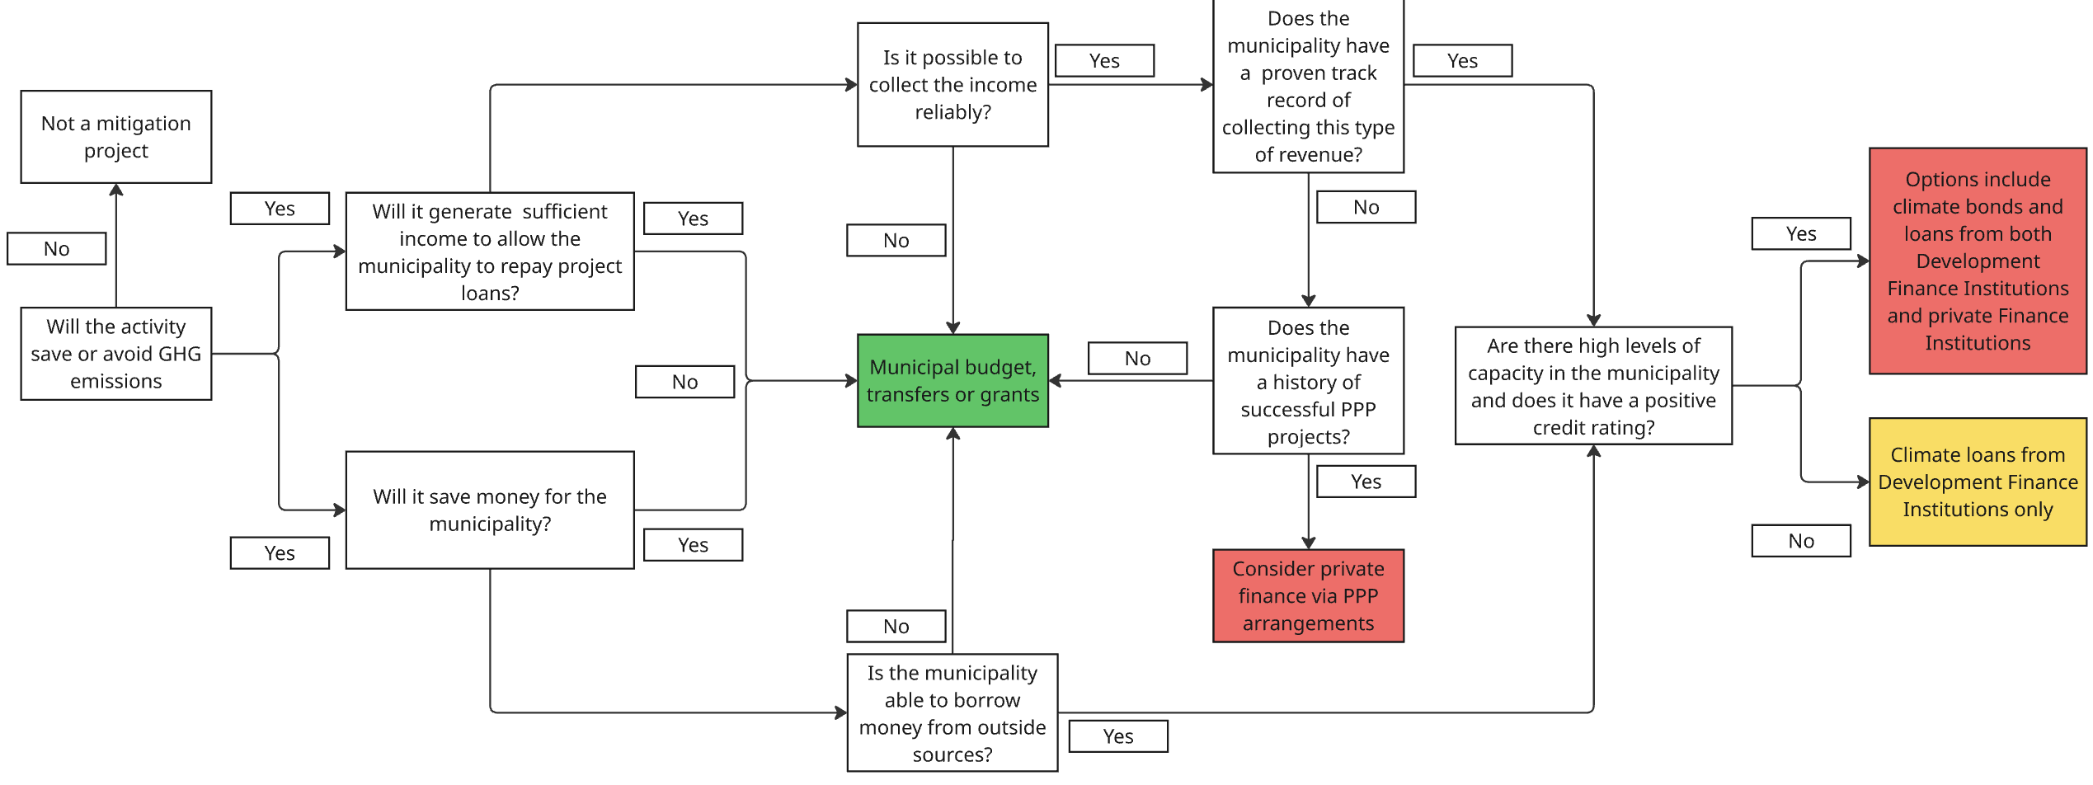
Funding options: Decision Tree

Slide 40
Process for accessing climate finance
Evaluate process and consider mainstreaming mitigation into municipal budgetary and planning processes
Step 3: Identify projects that require additional finance or project development support
Step 7: Develop early-stage climate-focused project proposal for shortlisted projects
Step 1: Identify main GHG emissions sources impacted by municipal actions
Step 2: Identify existing mitigation activities within budget, IDP and SDBIP
Step 4: Undertake feasibility assessment to create project shortlist
Step 8: Engage with funders and implement projects
Step 9: Update budgets and plans and capture learnings
Step 6: Match projects with available climate finance
Step 5: Prioritise projects based on local benefits

Slide 41
Step 1: Identify main sources of GHG emissions
Develop an inventory
OR
Look at other sources of information for ideas
Look across all sectors:
  Energy
  Transport
  Waste
  Industrial processes and product use
  Agriculture, Forestry and Land Use

Slide 42
Step 2: Identify existing activities that support mitigation
Scan the municipal budget, integrated development plan (IDP) and Service Delivery and Budget Implementation Plans (SDBIPs) for activities that have GHG implications
Identify those that have mitigation impacts (i.e. they reduce GHG emissions relative to if they were not implemented)
Sectors:
Energy and electricity | Environment and spatial planning
Transport and roads | Economic development
Water and sanitation | Infrastructure and technical services
Waste management | Municipal entities and agencies
Human settlements and housing | Municipal buildings, fleet and facilities

Slide 43
Sector | Examples of mitigation options
Energy | Building energy management systems (HVAC scheduling, load control, monitoring) and energy efficiency on municipal buildings Renewable energy on municipal office buildings, water and wastewater treatment works, workshops and depots Solar water heating on municipal-owned social housing or facilities Education campaigns for residential and commercial sector on reducing energy demand Roll-out of energy efficient lightbulbs Installation of smart meter devices LED retrofits for street lighting Facilitating Small-Scale Embedded Generation Integration of energy planning into IDPs
Transport | Municipal fleet right-sizing and route optimisation (reduces fuel consumption without capital spend — operational intervention) Municipal light vehicle fleet electrification (starting with pool vehicles and meter readers — short daily routes) NMT infrastructure — cycling lanes and pedestrian walkways (modal shift from private vehicles — land use planning mandate) Anti-idling policies and driver training for municipal fleet (low-cost behavioural intervention) Improved public transport services, including with electric vehicles
Sector | Examples of mitigation options
Water, Waste and waste-water | Energy-efficient pump scheduling for water distribution (shift pumping to off-peak, optimise pump systems) Pressure management in water reticulation networks (reduces pumping energy, reduces leaks, co-benefit for NRW) Variable speed drives on large municipal pumps and blowers (WWTW aeration blowers, borehole pumps) Waste minimization programmes Organic waste separation and composting/anaerobic digestion Materials recovery facilities / recycling buy-back centres Landfill methane capture and flaring or electricity generation Reducing open burning Biogas-to-electricity from wastewater sludge at larger WWTWs
Agriculture, forestry and land use | Urban greening and tree planting Wetland and open space protection Fire management programmes Land-use planning to limit conversion of natural land Support for sustainable/climate-smart agriculture Support for urban agriculture and community food gardens
Land use, planning, and regulation | SSEG bylaw adoption Green building performance standards in building regulations Urban densification along public transport corridors Development charges or density bonuses for energy-efficient buildings Sustainable public procurement policy with lifecycle emissions criteria

Slide 44
Step 3: Identify projects that require additional finance or project development support
Engage with the individuals in relevant departments responsible for planning and implementing identified mitigation actions.
Aim is to understand whether any of the identified activities could be expanded if additional financing becomes available.
This can either be because additional budget will enable the scale of the activity to increase, or because additional budget can fund additional project preparation work needed to scale up the activity or to plan additional phases that may happen in the current or future budget periods.

Slide 45
Step 4: Feasibility assessments to create project shortlist
Accessing climate finance requires effort, and so it is advisable to focus on activities most likely to succeed and have the highest impact. To identify these projects, it is important to consider factors like:
  Is the project design sufficiently complete to support a detailed feasibility assessment?
  To what extent is the success of the project within the control of the municipality?
  Have all project risks been adequately considered?
  Are the right conditions in place for it to succeed?
  Does the project align with municipal mandates and goals?
  Is the project cost-effective?
  If successful, will the project have a significant mitigation impact?
Aim is to identify projects that:
  have a high likelihood of successfully accessing climate finance in their current form;
  show promise but need additional project preparation support; and
  are unlikely to qualify for climate finance in their current form.

Slide 46
Step 5: Prioritise projects based on local benefits
Maximising local benefits is likely to be the most effective way build support for mitigation at local government level.
Utilising co-benefits of mitigation actions to support service delivery is crucial to ensuring that the benefits of a low-carbon transition accrue to everyone in society.
Most projects identified as mitigation projects will have been developed to address specific municipal priorities, it is important to capture these benefits first.
Once this has been done, the benefits that typically accompany mitigation actions should be considered and added to the list of project benefits where relevant.
Identifying benefits that accrue to groups of people targeted by social policy in South Africa could help to identify non-climate conditional grants that could also be a source of finance for mitigation projects (e.g. MIG for projects where poor households benefit).

Slide 47
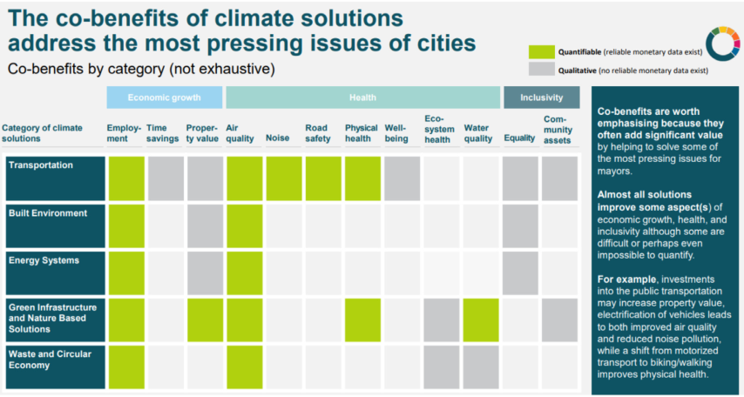

Slide 48
Step 6: Match projects with available finance
Create a list of funders to help identify which could be suited for this activity
Funding changes regularly but the guide has a list of possible options
Worth summarizing information like the following:
Name of institution | Time before funding will become available
Contact details | Geographic coverage
Type of funding available (e.g loan/grant/project preparation support) | Type of interventions that can be funded (e.g. mitigation/energy poverty/just transition)
Scale of funding available | Sectors covered (e.g. water/energy/waste/circular economy)
Deadline for application (if relevant) | Any other criteria for accessing the funding (e.g. benefit to a disadvantaged group like the poor, youth, women, disabled, etc)

Slide 49
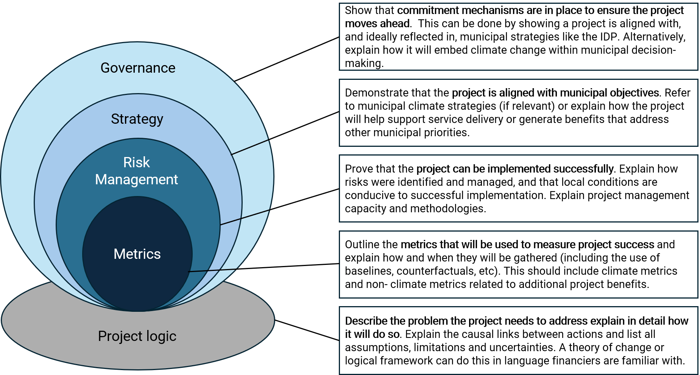
Step 7: Develop early-stage climate-focused project proposals
Requirements differ depending on funder. Iterative process

Slide 50
Step 8: Engage with finance providers and implement projects
Engagement with finance providers can commence in earnest once early-stage finance proposals are in place.
E.g. complete a template and receiving funding, or require numerous back-and-forth engagements.
Capture learnings from these engagements that can help to prepare better early-stage proposals in future.
Depending on how fast money is disbursed, projects may commence within the current municipal budget or IDP cycle. If this is not the case, go to Step 9.
Special attention to ensuring the MRE processes outlined in finance proposals or applications followed.
  Required to prove project was a success, key to accessing future financing from the same provider.

Slide 51
Step 9: Update budgets and plans and capture learnings
Once climate finance has been secured it should be reflected in municipal budgets, plans (IDPs, SDBIPs, mitigation plans, etc) and strategies (e.g. climate change strategy).
Access to climate finance should not be once off but become a continuing source of support for service delivery. Important to capture as many learnings as possible to make climate finance easier and cheaper in future.
Create dedicated structures to ensure capacity and skills to obtain climate finance.
Having activities coached within a broader mitigation or climate change strategy helps convince funders that a municipality is committed to mitigation and could increase the likelihood of being funded.
Carbon Budget Tagging (CBT): labelling and categorising budget items as supporting, not impacting or negatively impacting climate goals like mitigation. Helps to show link between mitigation and service delivery and create an awareness of GHG emissions and mitigation action throughout the municipality.

Slide 52
Exercise/discussion

Slide 53
6
Mainstreaming climate mitigation

Slide 54
Bringing climate mitigation into policy and planning
We're designing a step-by-step process that any municipality in South Africa could follow to factor climate mitigation into its planning and decision-making.
The aim is to produce a draft process map and/or set of questions which we can use.

Slide 55
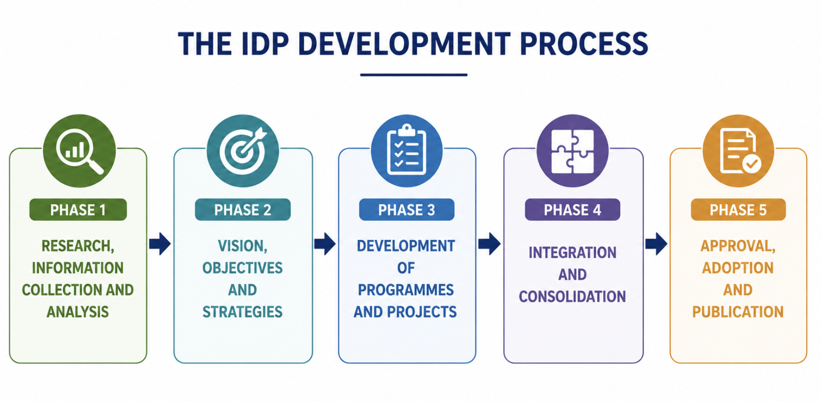
https://pari.org.za/wp-content/uploads/2026/02/Final-Revised-IDP-GUIDELINES-2020-For-all-categories-of-municipalities.pdf

Slide 56
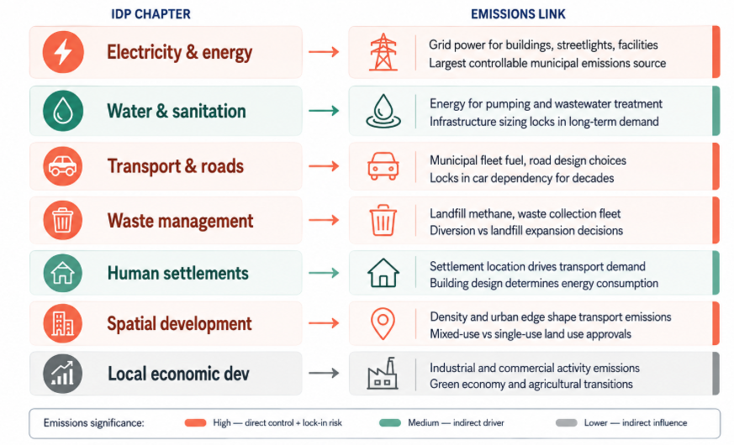
Development of projects and programmes

Slide 57
Examples 1. Integrated Waste Management Plan
Is there a target is set for increasing landfill diversion rate?
Does the plan prioritise organic waste diversion?
If landfill expansion or a new landfill is proposed, has a landfill gas capture system been included in the design specification? Is it costed?
Does the plan address the waste collection fleet — fuel type, route optimisation, vehicle replacement schedule?
Are there recycling or recovery targets that would reduce demand for virgin material production (an indirect but significant emissions reduction)?
If the municipality is a district, does the plan coordinate with local municipalities on separation at source and transfer station design?

Slide 58
Examples 2. Supply Chain Management Policy
Do specifications for energy-consuming equipment (HVAC, pumps, lighting, vehicles) include lifecycle energy cost or minimum efficiency standards - not just capital cost?
Do specifications for vehicles and fleet include fuel efficiency or emissions thresholds?
For construction contracts (roads, buildings, bulk infrastructure), do tender criteria include embodied carbon or material efficiency?
For electricity procurement, does the policy enable or constrain purchasing from renewable sources, IPPs, or municipal embedded generation?
Do specifications for street lighting, traffic signals, and public facility equipment default to highest available efficiency?

Slide 59
Examples 3. Infrastructure and capital project scoping
What is the expected lifespan of infrastructure? If over 15 years, has the project been assessed for emissions lock-in - will it still make sense in a lower-carbon future?
Does the project increase or decrease the municipality's electricity consumption or fuel use? By roughly how much, annually?
Has a lower-emission alternative been formally considered - even if it was rejected? (This is an audit trail question. The point is that the option was on the table.)
Does the project's design standard enable future retrofitting or fuel-switching, or does it lock in a single energy source? A building designed for solar PV readiness costs marginally more now and avoids expensive retrofit later.
If the project is road infrastructure, does it include NMT provision (pedestrian and cycling facilities) as a default, or was NMT explicitly scoped out with a stated reason?
If the project is bulk water or sanitation infrastructure, has the pumping energy requirement been optimised - gravity-fed options, variable speed drives, right-sizing?

Slide 60

Questions
Does this guide seem useful to you?
Does it make sense to have separate questions per chapter?
  Are these the right chapters?
How detailed must the questions be?
Any suggestions of additional material for ensuring the guide is useful?

Slide 61
7
Closure

Slide 62

Closure
Thank you
Certificate of attendance
Meetings with coordinators of data collection
  Collect data for 2025 but if not available collect for latest year
Platform
  Training materials
  Dissemination
Final meeting in February

Slide 63
brett@thinka.co.za (Brett Cohen)
luanne@jacali.net (Luanne Stevens)
flmoni85@gmail.com (Funmilola Oni-Adeniyi)
elanie@caelus.co.za (Elanie Van Staden)

