Slide 1
Climate change and the Climate Change Act
MP tools and guidelines training workshop
Day 2
1 September 2026

Slide 2
Welcome and brief recap

Slide 3
1
Objectives of today’s workshop

Slide 4
Objectives
Improve the understanding and purpose of a GHG inventory – community and local government operational control
Build capacity on compiling a municipal and provincial GHG inventory by
  Taking everyone through the developed data collection guidance document
  Completing exercises on how to collect, utilise, adapt and quality check data
  Taking everyone through the developed GHG inventory tool for municipalities
  Completing exercises on how to input activity data and interpret output data in the GHG inventory tool.
Process will also be used to pilot and refine the data collection guidance and inventory tool by
  Learning from you what the needs are and what the data sources are
Allocate responsibilities to individuals for collecting data for the:
  District inventories
  Provincial inventory
So please ask questions! Let us know when you don’t understand or where you think additional information is needed

Slide 5

2
Overview of GHG inventories

Slide 6

Importance of inventories

Slide 7
What does a GHG Inventory show and why is this important?
Total emissions show what a region is producing overall
Sectoral emissions show which are the dominant emitting sectors
Trends show which sectors may become dominant in future
Indicates where to focus resources to reduce emissions
Developing a GHG inventory is an essential first step toward managing emissions

Slide 8

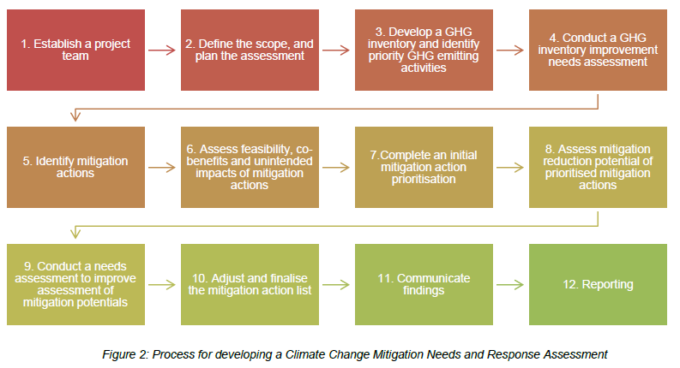
How can municipalities use their inventory?
GHG inventory can be used in the development of your Needs and Response Assessment which is a Climate Change Act requirement
Assists in identifying key sectors for targeting in terms of mitigation planning

Slide 9
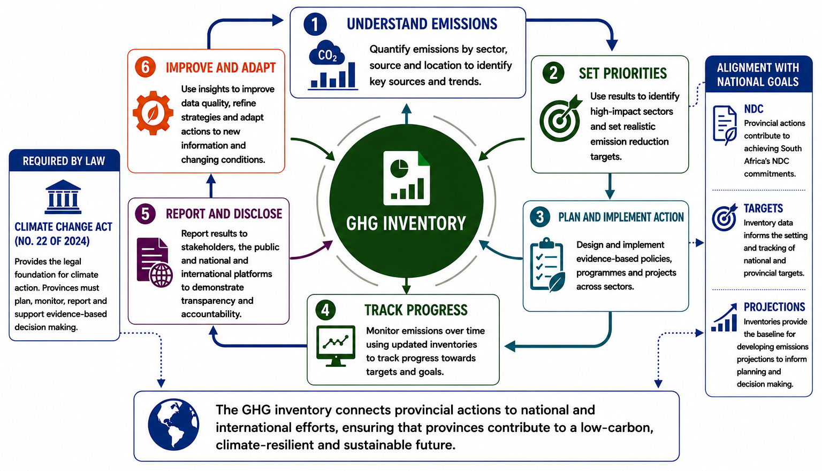
How province can use their inventory?

Slide 10

Framework for developing inventories

Slide 11
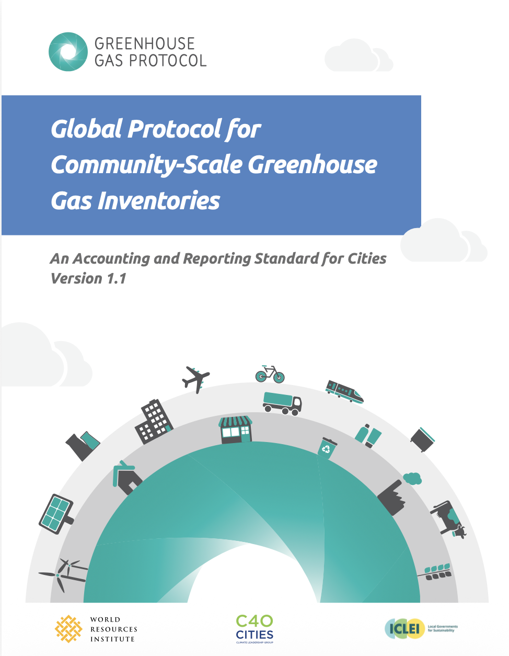
Provides guidance on community scale inventories.
Offers a robust and clear framework that builds on existing methodologies for calculating and reporting city-wide/municipal GHG emissions.
Provides clear guidance on how inventory boundaries should be defined.
Can be applied for any sub-national area. Province, districts, local municipalities, etc.

Slide 12
Transportation
Waste
IPPU
AFOLU
Stationary
Residential
Commercial & institutional
Manufacturing
Energy industries
Other and fugitive
Industrial processes
Product use
Livestock
Land use
Other
Road
Railways
Water-borne navigation
Aviation
Solid waste disposal
Biological treatment
Incineration and burning
Wastewater treatment
Off-road
Other scope 3
GPC
What sectors does the GPC Guidelines cover?

Slide 13
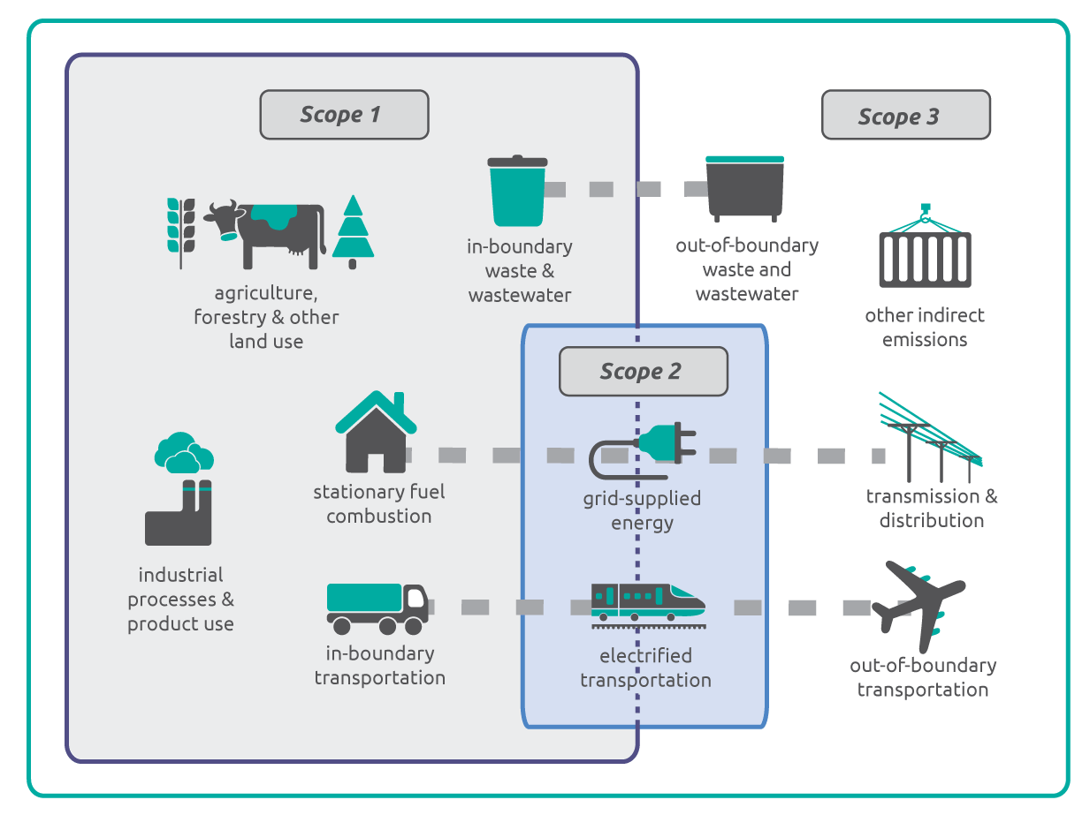
What else does the GPC Guidelines cover?

Slide 14
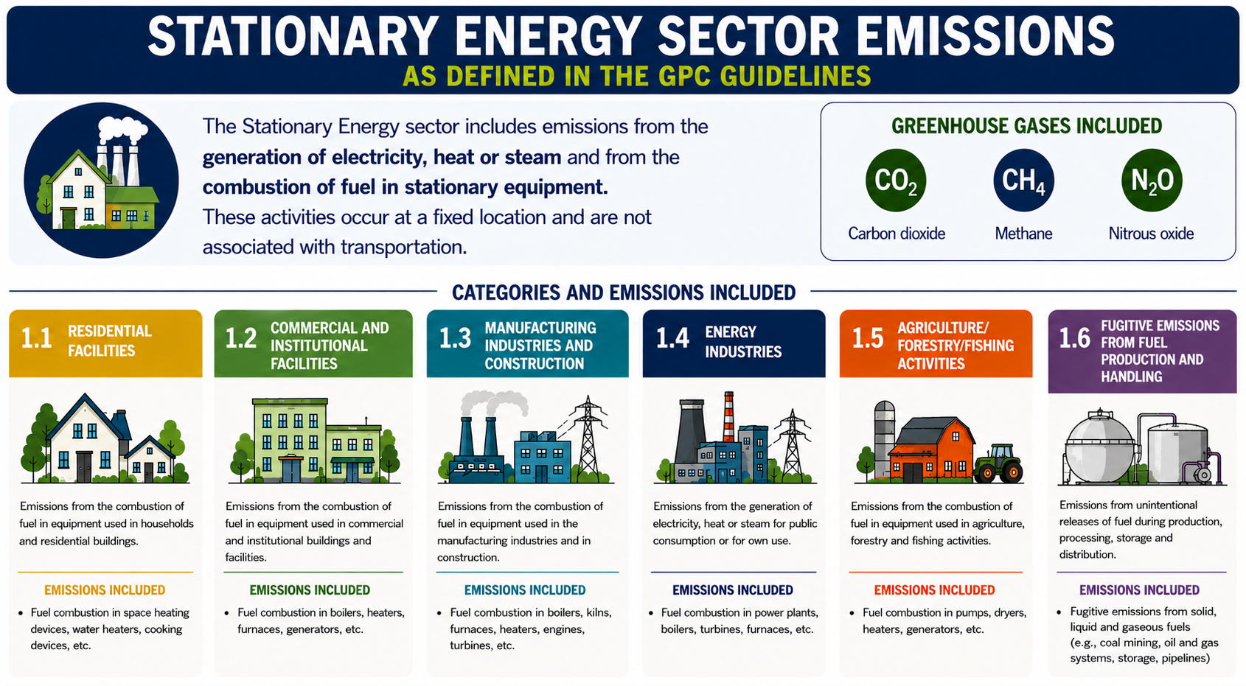

Slide 17
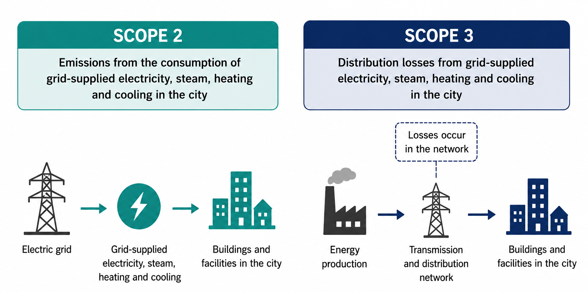

Slide 18
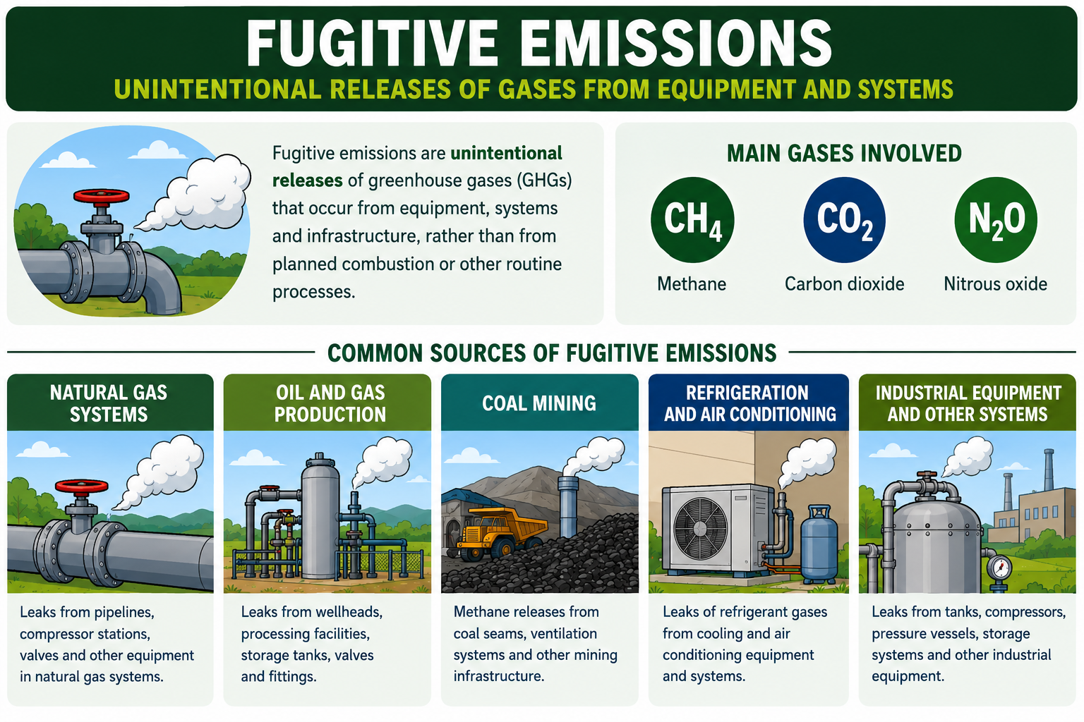

Slide 20
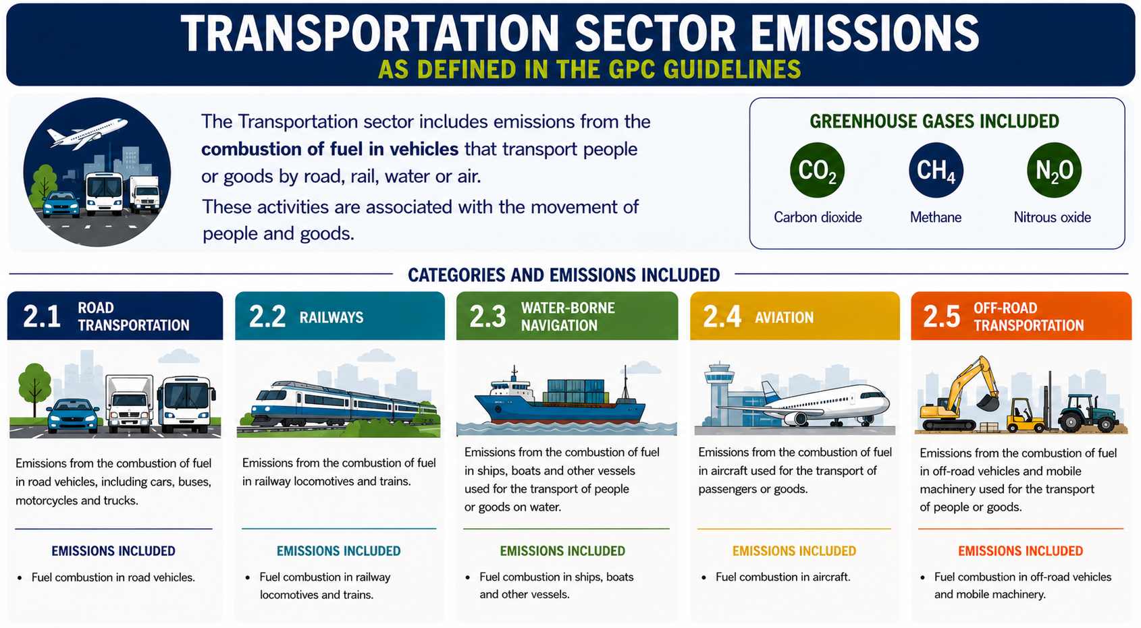

Slide 23
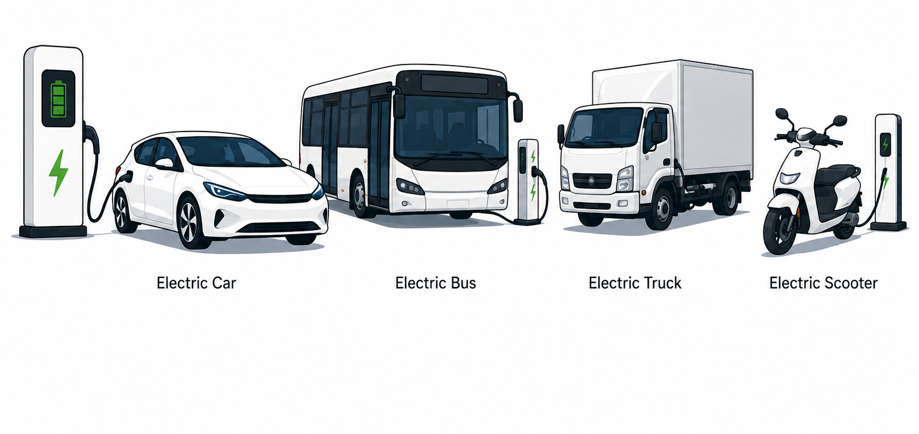
Scope 2 – electricity consumption

Slide 24
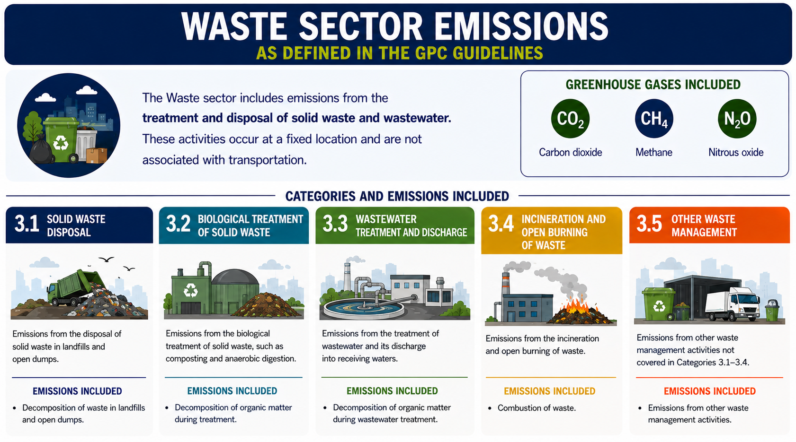

Slide 27
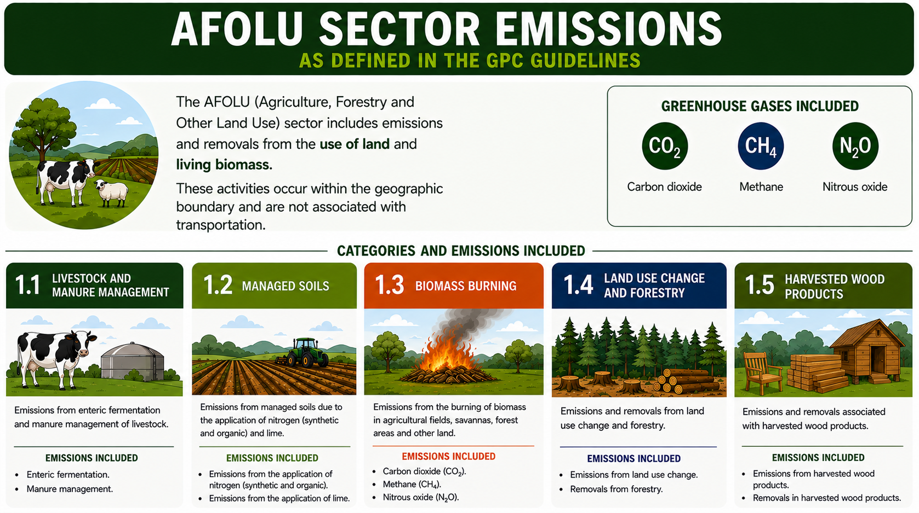

Slide 28
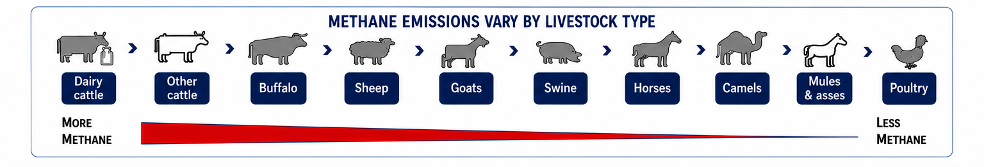

Slide 29
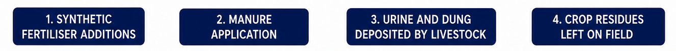

Slide 31
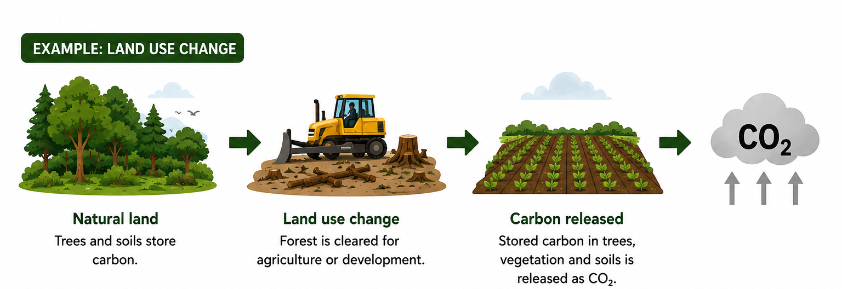
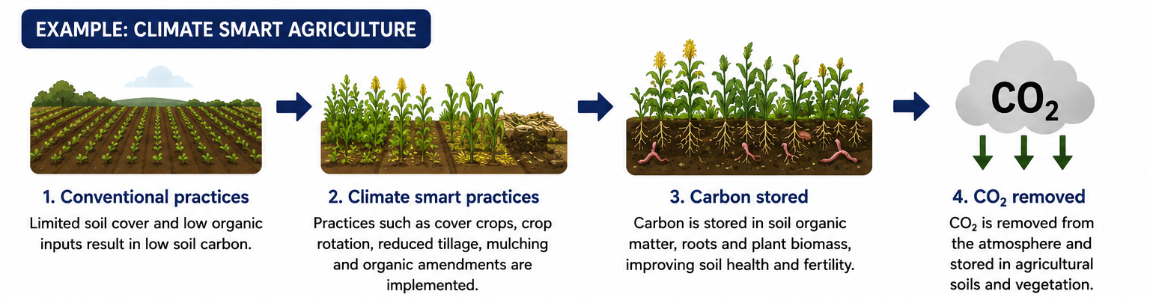

Slide 32

Exercise 1

Slide 33
Break-out group exercise
Look at the package of information and locate Exercise 1 on categories
Complete the table by matching the activities to the categories in each sector
Report back to the group
20 min

Slide 34
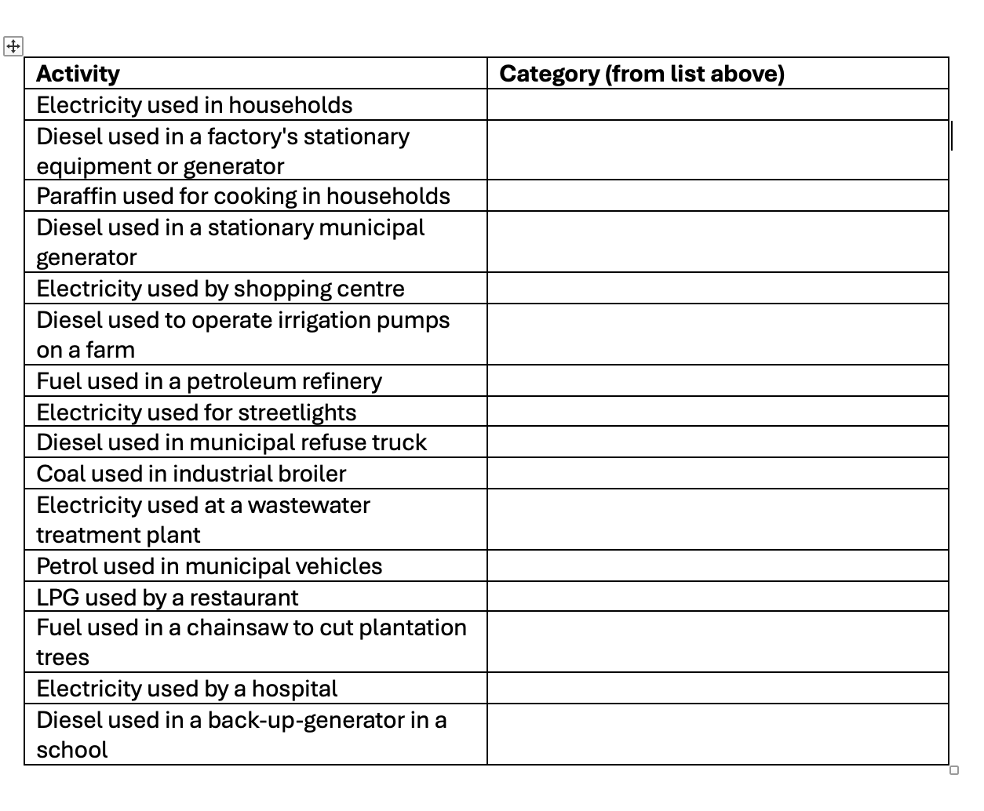
Stationary energy
Residential buildings (RB)
Commercial buildings and facilities (CBF)
Institutional buildings and facilities (IBF)
Manufacturing industries and construction (MIC)
Energy industries (EI)
Agriculture, forestry and fishing activities (AFF)
Non-specified sources
Fugitive emissions (FE)

Slide 35
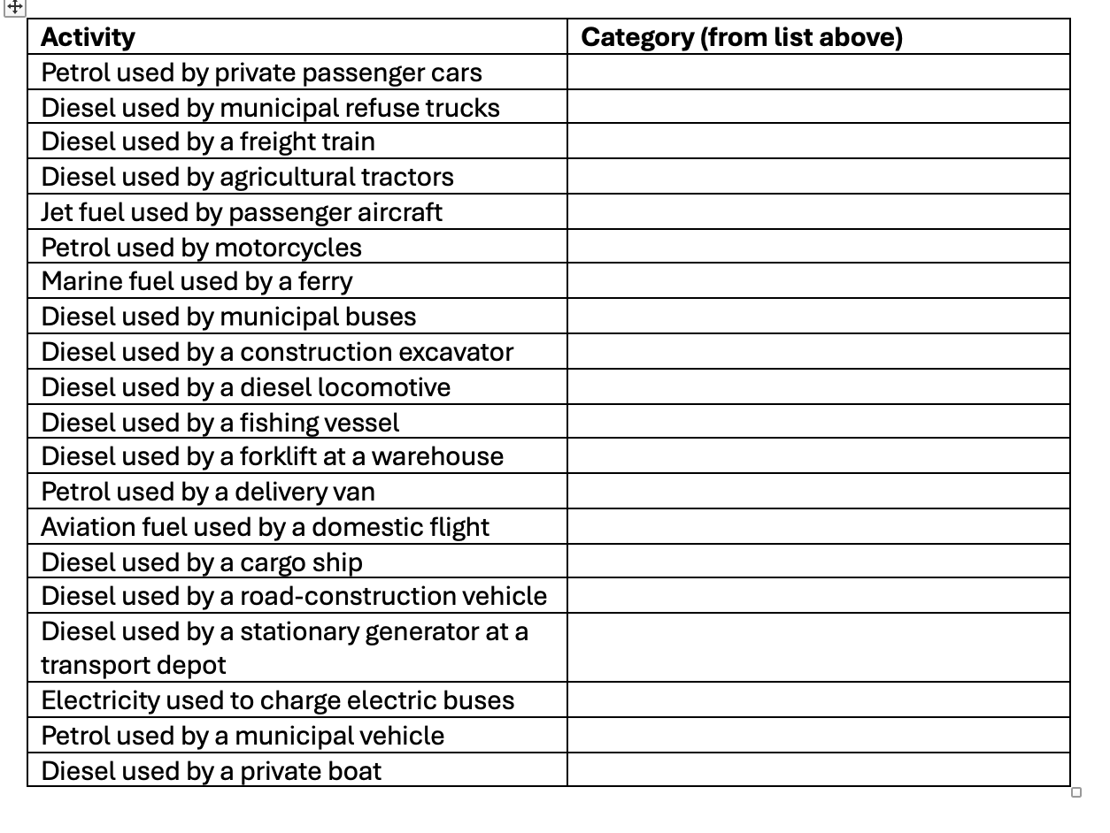
Transportation
On-road transportation (ONR)
Railways ®
Waterborne transportation (W)
Aviation (A)
Off-road transportation (OFFR)

Slide 36
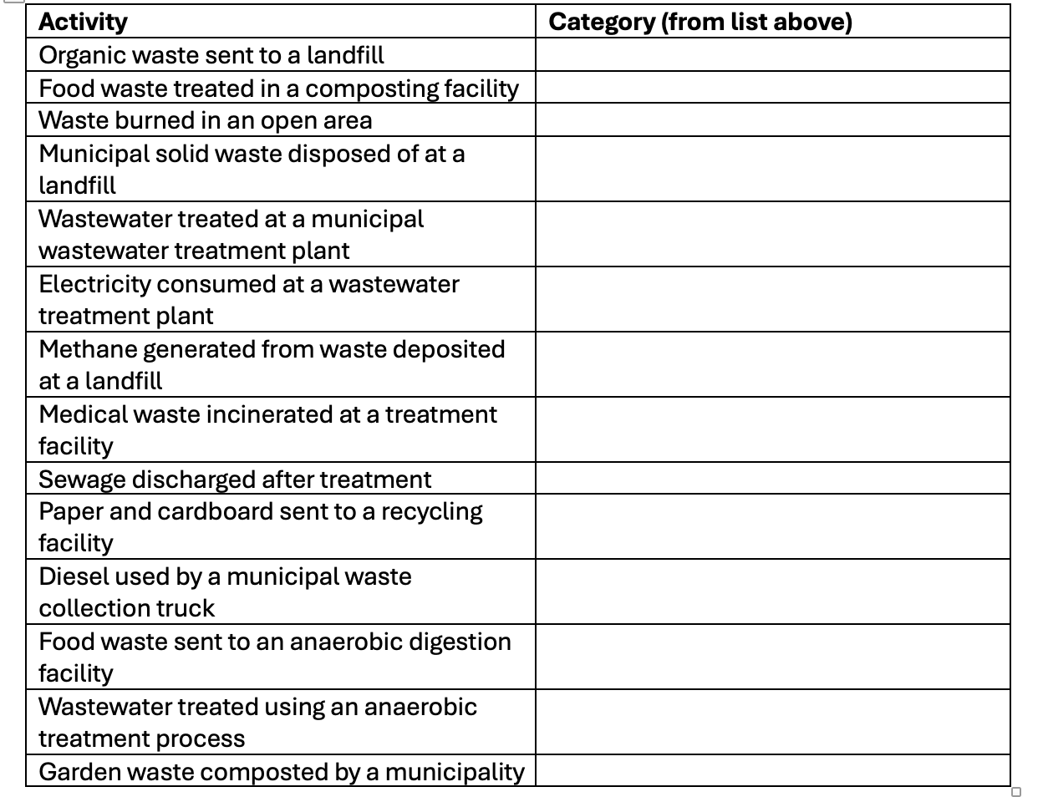
Waste
Solid waste disposal (SWD)
Biological treatment of waste (BT)
Incineration and open burning (IOB)
Wastewater treatment and discharge (WWTD)

Slide 37
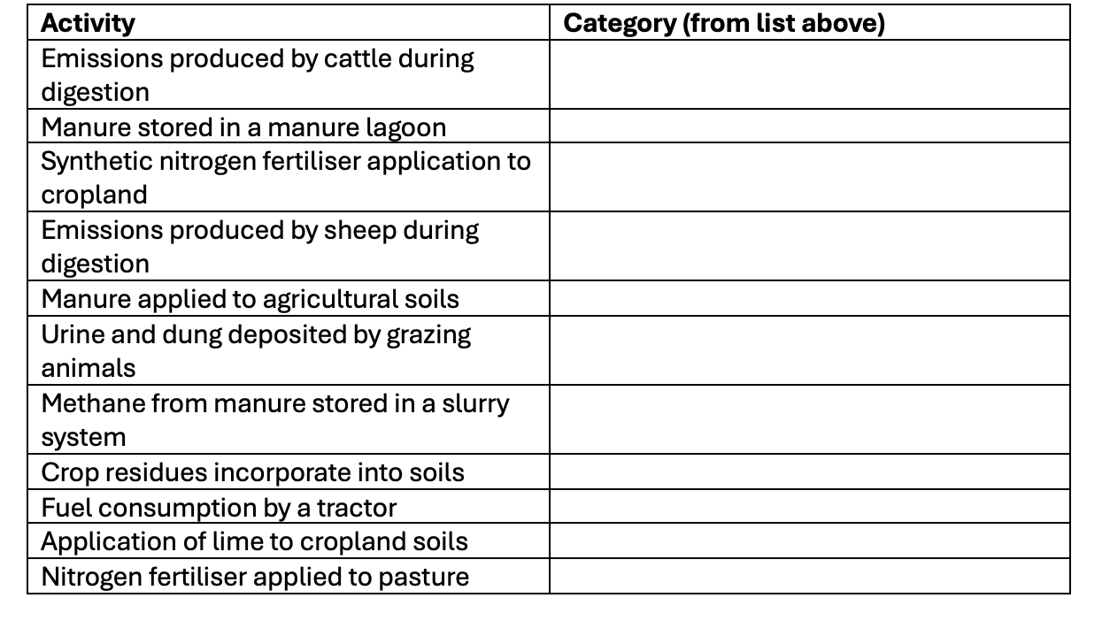
Agriculture
Livestock (enteric fermentation) (EF)
Livestock (manure management) (MM)
Managed soils (MS)

Slide 38

3
Data collection guideline

Slide 39
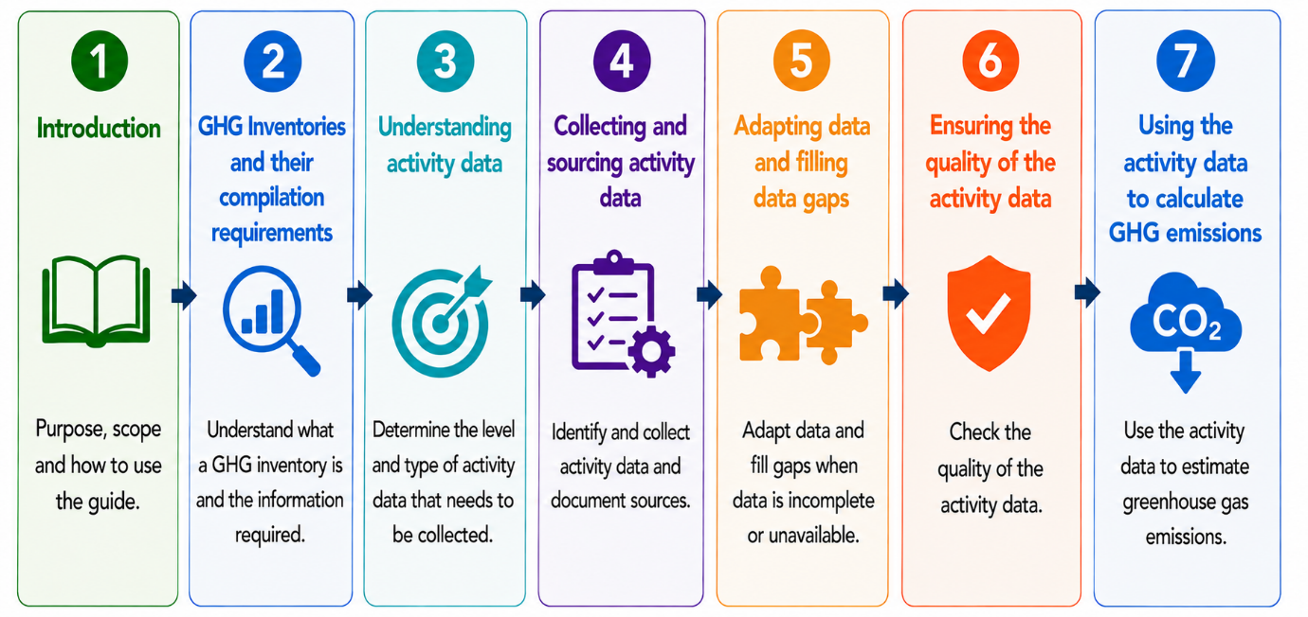
Structure of the guidance

Slide 40
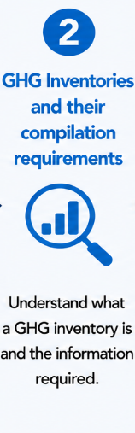
GHG inventories and their compilation requirements
What is a GHG inventory?
What is the GHG inventory boundary?
What type of information is required to compile a GHG inventory?

Slide 41

Inventory boundary

Slide 42
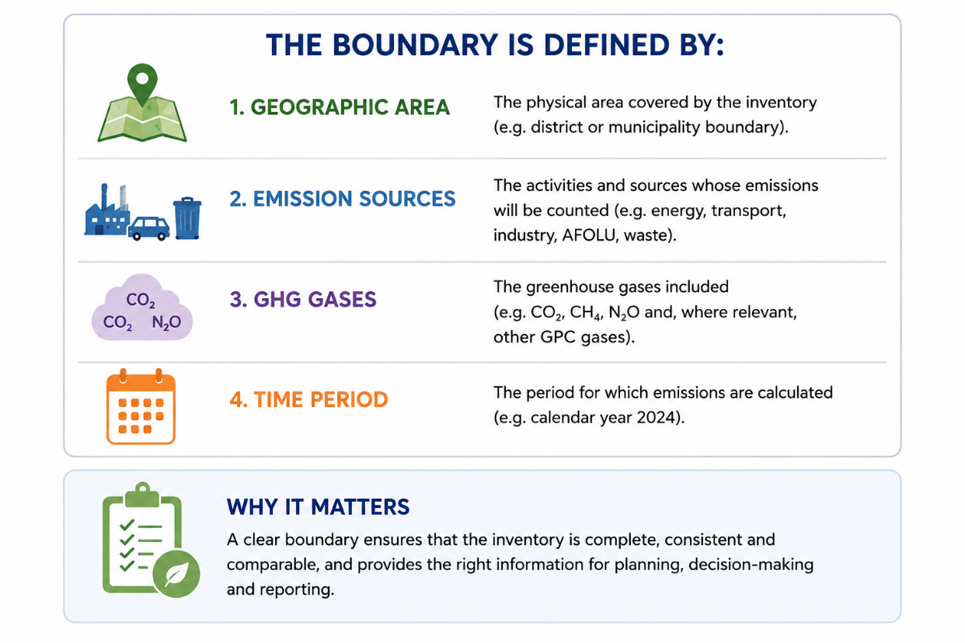

Slide 43
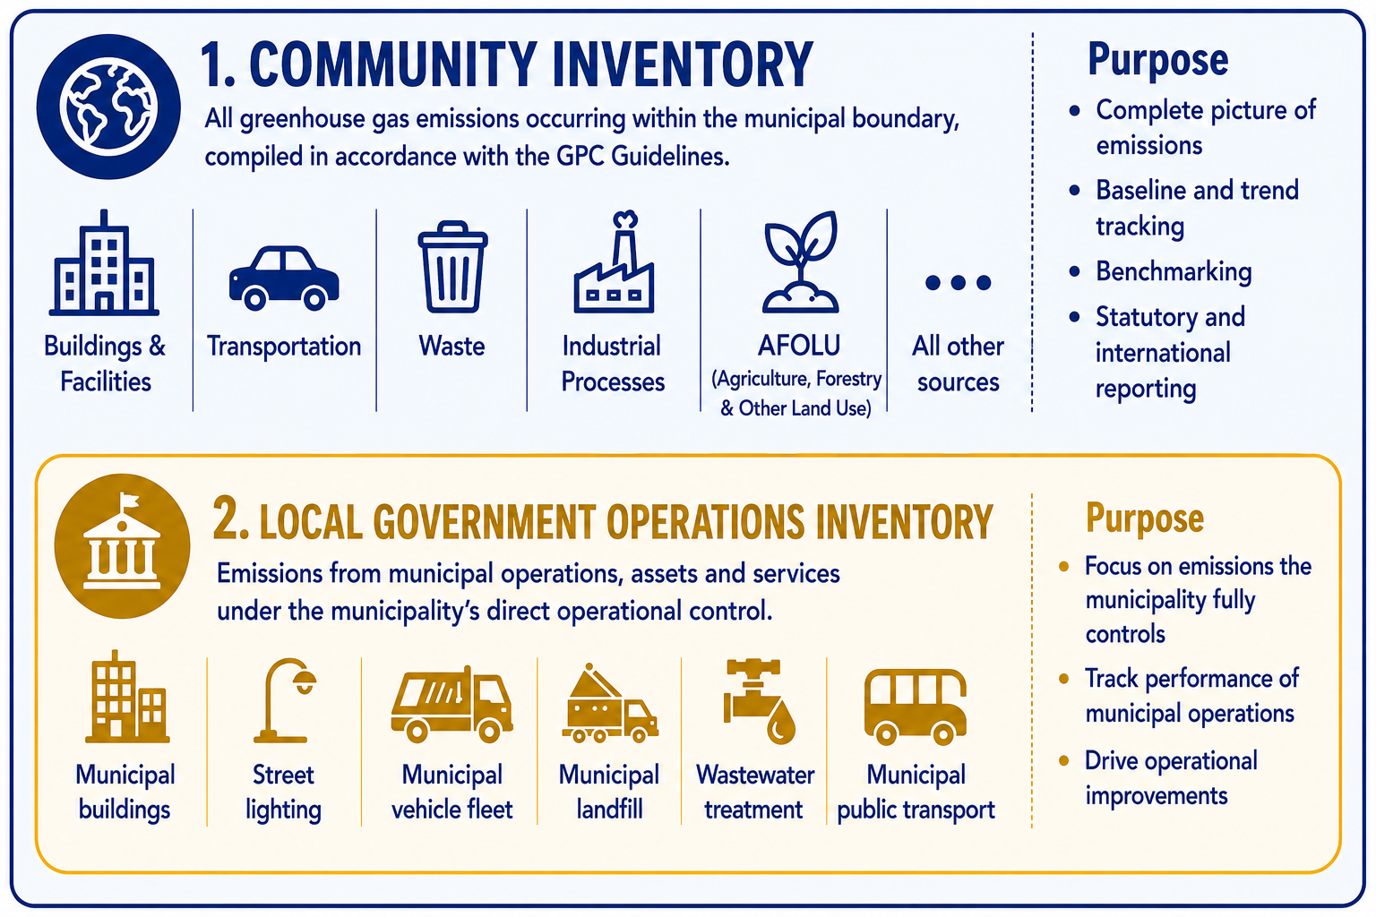
Types of emission inventories
Local government operations inventory includes the emissions for which the municipality/district or province is directly accountable and can reduce through operational decisions
  This will be different for each municipality/district/province as each have their own building, vehicles, etc
Carbon footprint

Slide 44
Types of emission inventories
Community inventory includes all GHG’s occurring within the municipal boundary.
As the community inventory is broad and covers all activities the community inventory for each municipality in a district can be added to form the district inventory.
In turn the district community inventories can be added to form the provincial inventory.

Slide 45

Test your knowledge
    Which of these are included in a Local Government Operations inventory? (Can select more than 1 answer)
    Residential emissions
    Private passenger transport emissions
    Wastewater treatment emissions
    Street lights
    Livestock emissions
    Fertiliser emissions
    Waste emissions
    Railway emissions
    Emissions from croplands
    Emissions from municipal buildings

Slide 46

Inventory requirements

Slide 47
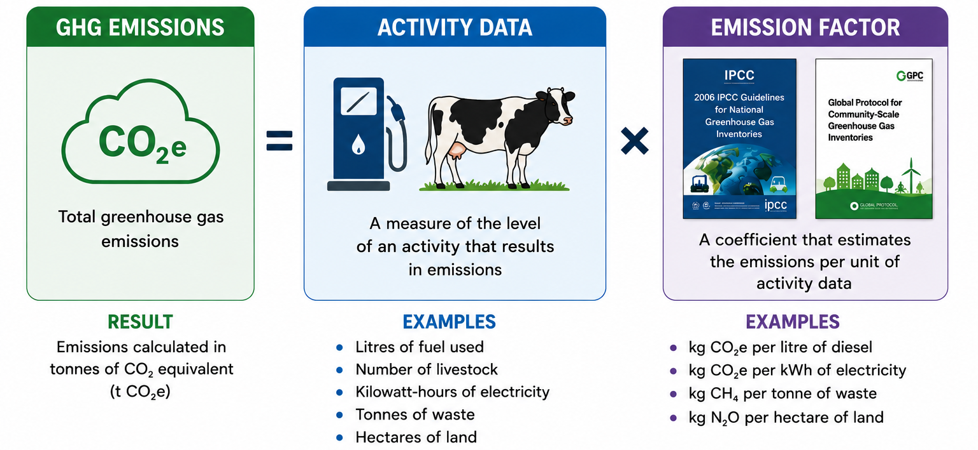


Information required for an inventory
Can be sourced from IPCC Guidelines, SA GHG Inventory, Technical Guidelines or international sources
Input data which needs to be sourced for each inventory – usually varies annually

Slide 48
Activity data requirements

Slide 49

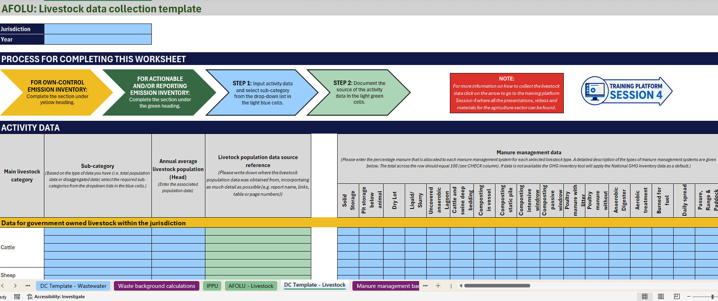
Data collection templates
https://ukpact.lateral.co.za/
UK PACT

Slide 50

Types of activity data

Slide 51
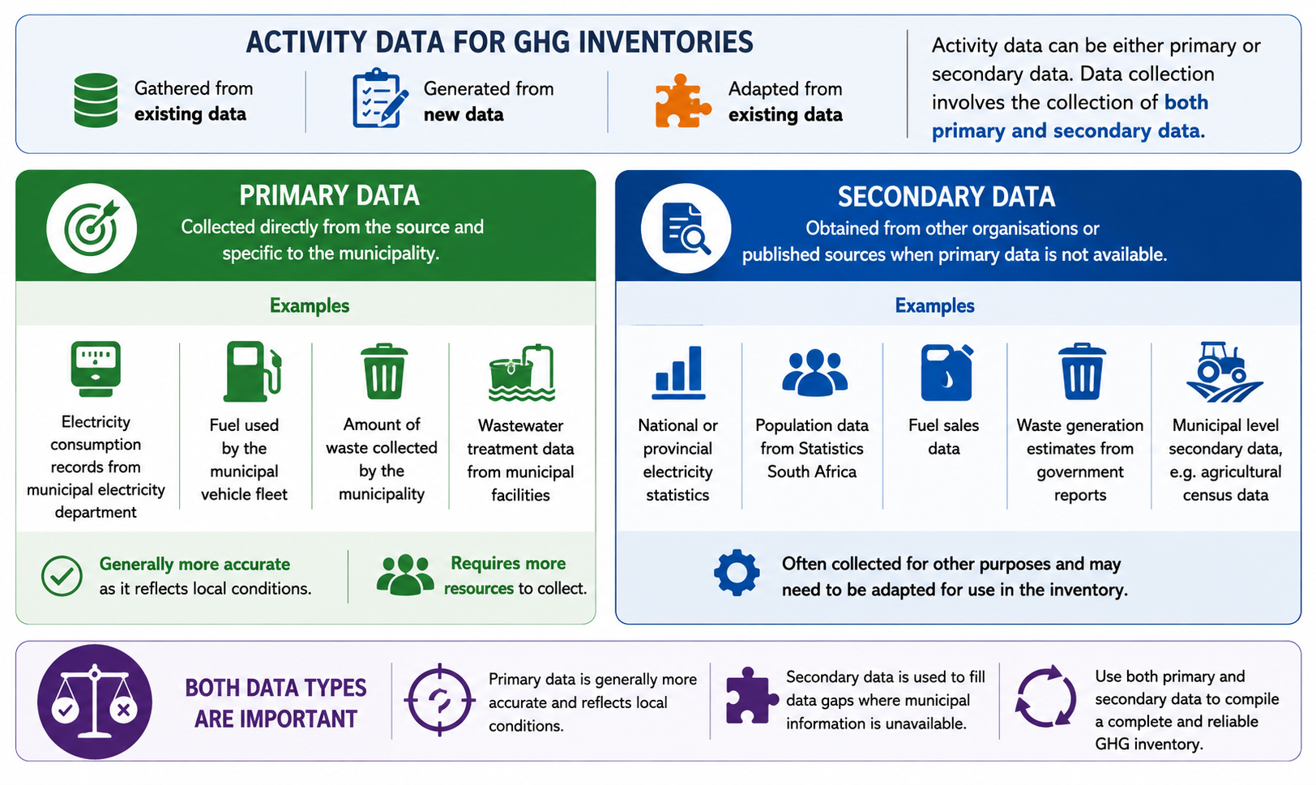
Types of activity data

Slide 52
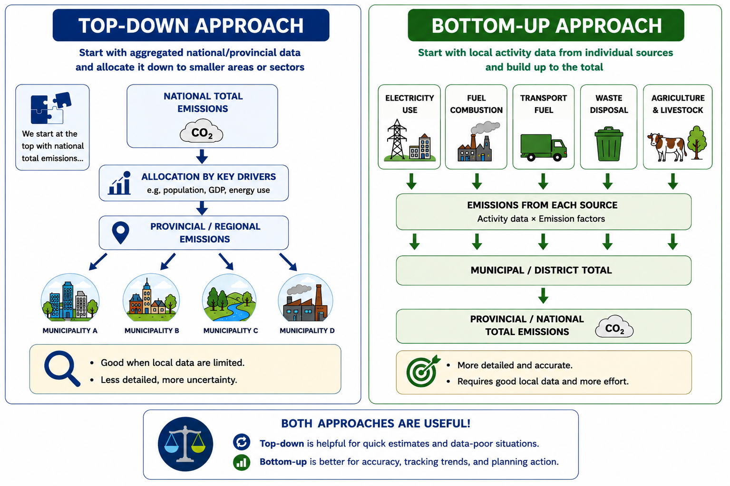
Approaches to compile a GHG inventory

Slide 53
Data collection approaches and procedures
Data collected at the local level (within your jurisdiction)
  Examples:
    Actual fuel purchase records from local companies
    Metered electricity consumption
    Vehicle mileage logs from municipal fleets
    Waste quantities measured at local landfills
    Production data reported by industries
    Local livestock counts
  Collecting local level data is resource intensive but generally has a high accuracy

Slide 54
Data collection approaches and procedures
As local level data collection is resource intensive it not often collected at this level
Data is more often available at the provincial or national level
If local level data is not available then provincial or national level data can be scaled down to district or municipal level using a related data set, such as:
  National average fuel use scaled by local population
  Provincial electricity consumption adjusted by number of households
  Regional waste generation rates multiplied by local population
  National livestock statistics scaled by agricultural land area
  Industry production estimated using employment numbers or economic output
This data is less accurate than actual local level data

Slide 55
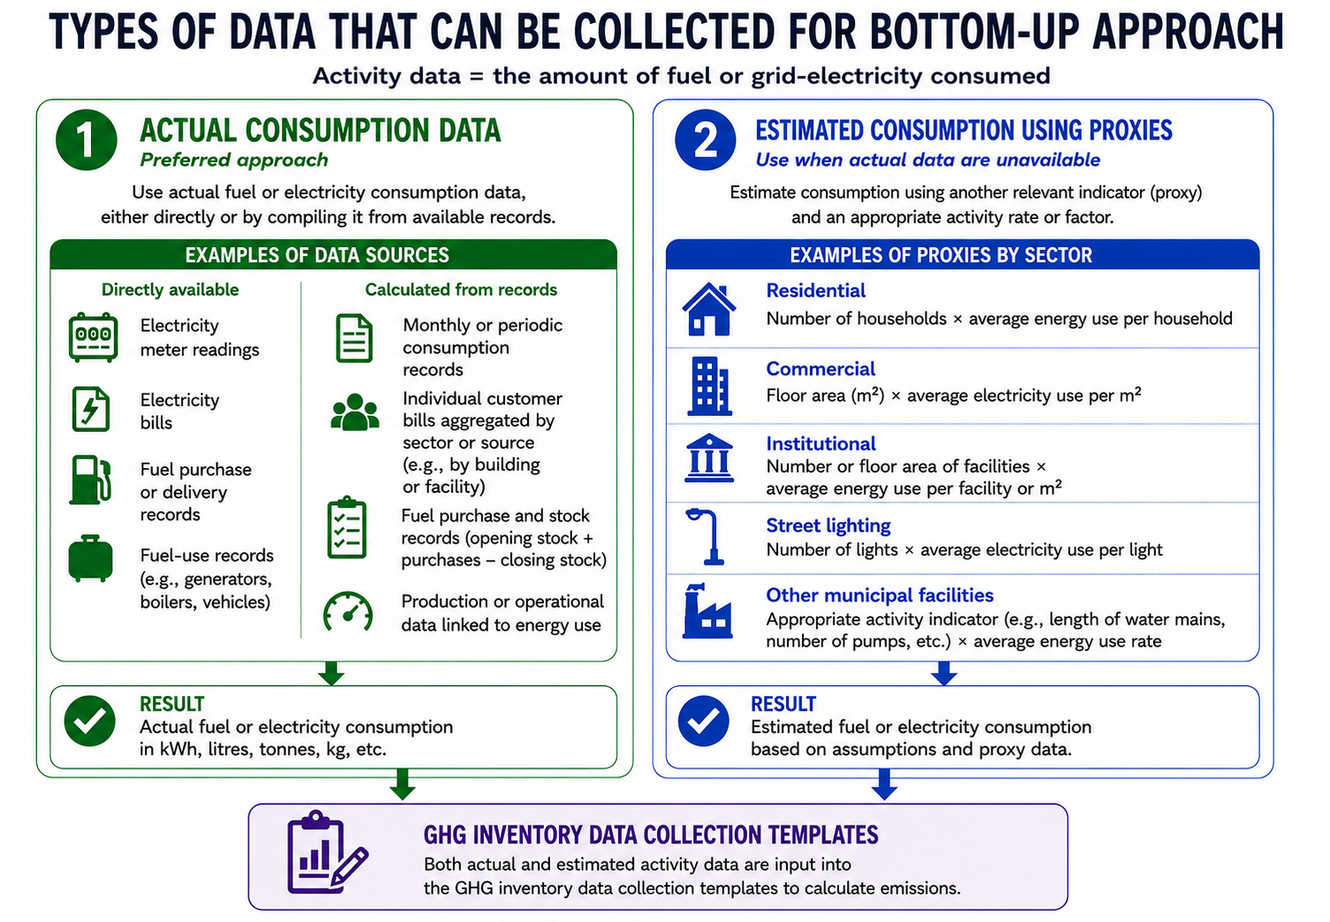

Slide 56
Collecting and sourcing activity data
Activity data requirements
Data collection templates
Collecting and preparing data for input to the templates
Sectoral data collection guidance:
  Stationary energy
  Transportation
  Waste
  Agriculture, Forestry and Other Land Use

Slide 57
Exercise 2

Slide 58
Break-out group exercise
A sheet showing the type of activity data needed for each category within each sector is provided.
Participants work in groups to identify:
What type of information or activity data is needed
Data sources for the activity data
Indicate if data source is at municipal, district or provincial level
Indicate if there are data gaps
Consider all categories
Think:
What activity is happening? → What number describes that activity? → What unit is it measured in? → Who has the data? → Is the data available?
You will have 15 minutes for each sector then we will review the findings

Slide 59
7
Summary and close of day 2

Slide 60
brett@thinka.co.za (Brett Cohen)
luanne@jacali.net (Luanne Stevens)
flmoni85@gmail.com (Funmilola Oni-Adeniyi)
elanie@caelus.co.za (Elanie Van Staden)

