Slide 1
Climate change and the Climate Change Act
MP tools and guidelines training workshop
Day 1
31 August 2026

Slide 2
1
Welcome, introduction and workshop objectives

Slide 3
WELCOME!

Slide 4

Project overview

Slide 5
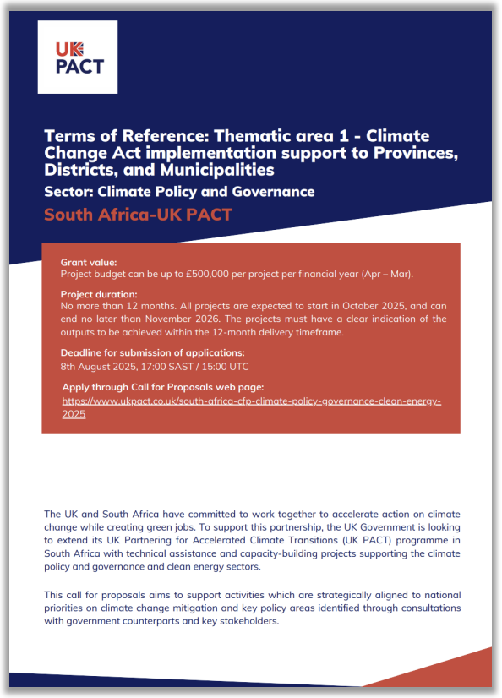
UK PACT: Enabling implementation of the Climate Change Act at subnational level
UK PACT (Partnering for Accelerated Climate Transitions) is a UK climate finance programme that supports capacity building and technical expertise to accelerate climate action.
The South Africa-UK PACT Country Fund is demand-driven and aligns its support with South Africa’s existing climate plans and policies.
This initiative will support provincial and municipal governments to build the capacity and readiness needed to implement the Climate Change Act 22 of 2024.
Developed in collaboration with DFFE and SALGA, with UK PACT providing technical and financial support.
Support will focus on helping provinces and municipalities align their policies, plans and processes with the requirements of the Climate Change Act.

Slide 6
Project objectives
Develop support materials:
  Develop guidance documents, tools, and templates to enable provinces and municipalities to comply with the mitigation requirements of CCA.
Operationalise tools:
  Support provincial and municipal officials to develop knowledge to utilise and implement these guidance documents and tools, thus accelerating their climate action.
Increase Knowledge Sharing:
  Develop a Climate Change Act Support Platform (CCASP) to disseminate CCA-related tools and information across various stakeholders.
Support inventory development:
  Support MP Province and districts in developing/updating of their GHG inventories.

Slide 7
Key project milestones
Milestone | Date
Inception | April 2026
Needs assessment workshop | 7 May 2026
First inventory training | 8 May 2026
Tools development | May – October 2026
Mentoring and tool operationalisation with champions | May 2026 – February 2027
Face to face training on tools an inventories | August-September 2026
Inventory development and data collection | May – November 2026
Inventory report | October – December 2026
Finalisation of information system | February 2027
Knowledge sharing session | February 2027

Slide 8
Objectives of this week’s training
Introduce the draft frameworks and tools that have been developed to support Climate Change Act implementation at the sub-national level
Obtain inputs on improvements that could be made – Help us shape the tools and guidance documents!
Build capacity on greenhouse gas inventories and start the data collection process
Workshop is participatory and we want you to get as much as you can from it. So please contribute as much as you can, so that we and your colleagues can learn from you!

Slide 9
Icebreaker

Slide 10


Slide 11
2
Overview of the Climate Change Act

Slide 12



What the Act does
OBJECTIVES
KEY PRINCIPLES
GOVERNANCE AND INSTITUTIONAL FRAMEWORK
Create a coordinated response to climate change
Ensure the country is ready for climate change and is able to recover quickly
Shift to a cleaner economy in a fair way
Meet international obligations
Protect current and future generations
Sustainable development
Fair treatment for everyone in climate issues
Making choices based on facts and data
Protection of vulnerable groups
Climate action must be taken by all levels of government
Requires coordination between:
  National departments
  Provinces
  Municipalities
Integrates climate into all policy areas

Slide 13


Roles and responsibilities in the Act
Sets the direction, standards and rules for climate action
Adapt national policies to regional contexts and ensure coordination within their areas
Responsible for on-the-ground action and service delivery

Slide 14


Cooperative governance
Policies and plans must be aligned vertically
Climate action is a shared responsibility
Each level must support and coordinate with the others
Mandatory cooperation across all levels of government

Slide 15


Structure of the Act
Foundation layer
1: INTERPRETATION AND PRINCIPLES
2: POLICY AND INSTITUTIONS
Definitions
Objectives
Principles
Policy alignment
Govt coordination
Institutions

Slide 16

Structure of the Act
Government Action
3: PROVINCES AND LOCAL
Risk assessments
Climate plans
Local response
Will come back to this later as this is the important chapter in terms of this session

Slide 17


Structure of the Act
Climate response core
4: ADAPTATION
5: MITIGATION
National strategy
Sector plans
Resilience
Emission targets
Carbon budgets
Monitoring
Reporting

Slide 18


Structure of the Act
Implementation
6: GENERAL MATTERS AND TRANSITIONAL PROVISIONS
SCHEDULES
National strategy
Sector plans
Resilience
Sectors listed
Responsibilities
Legal amendments

Slide 19
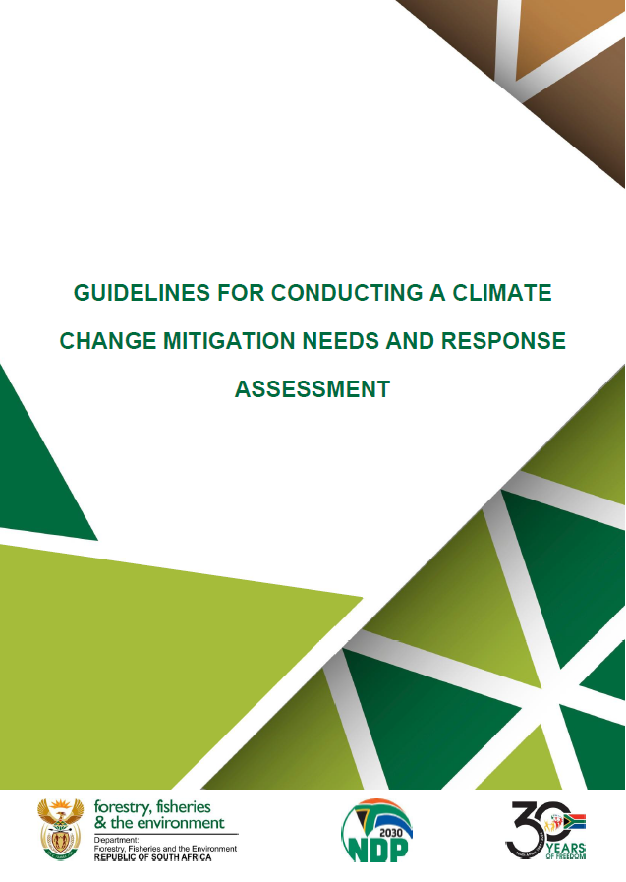
Chapter 3: Climate change response: Provinces and Municipalities
Section 17 – Climate change response
  Provincial and municipal responsibilities are:
Climate change needs and response assessment:
  Member of the Executive Council for a province and mayor of a metropolitan or district municipality must, within 1 year of publication of the National Adaptation Strategy and Plan, undertake a climate change needs and response assessment for their area (province, metropolitan, or district municipality)
Assessment must look at:
How climate change affects constitutionally mandated functions, and
Identify steps to address those effects

Slide 20
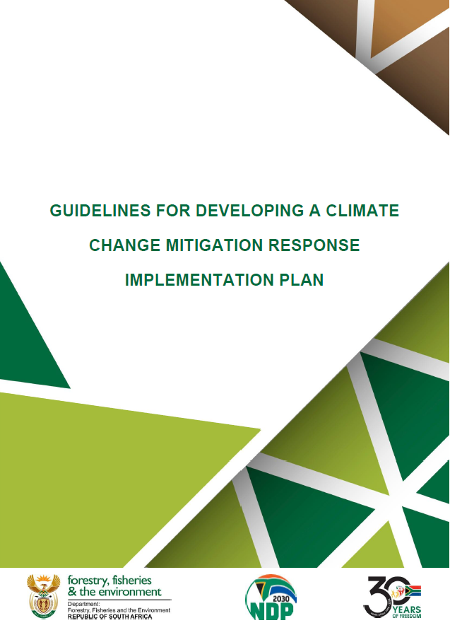
Chapter 3: Climate change response: Provinces and Municipalities
Section 17 – Climate change response
  Provincial and municipal responsibilities are:
Climate change needs and response assessment;
Review and publication of the assessment;
Climate change response implementation plan:
  Within two years of completing the needs and response assessment, the MEC or mayor must develop, implement, and publish a climate change response implementation plan
Implementation plan must:
Be informed by the Needs and Response Assessment,
Include both adaptation and mitigation measures, and
Comply with requirements prescribed by the Minister

Slide 21
Chapter 3: Climate change response: Provinces and Municipalities
Section 17 – Climate change response
  Provincial and municipal responsibilities are:
Climate change needs and response assessment;
Review and publication of the assessment;
Climate change response implementation plan;
Integration into planning instruments:
  For provinces: the response implementation plan must be incorporated into the province’s environmental implementation plan required under the National Environmental Management Act.
  For municipalities: it must be incorporated into the municipality’s Integrated Development Plan (IDP) under the Municipal Systems Act

Slide 22
Chapter 3: Climate change response: Provinces and Municipalities
Section 18 – Finance mechanism
This section requires the Minister to set out a financial support mechanism to help governments implement their climate plans:
  The Minister of Environment must, in consultation with the Minister of Finance, prescribe a mechanism to support and finance climate change response, planning, and implementation by national, provincial, and local government.
  This finance mechanism is intended to enable the response measures required by the Act, ensuring that governments at all levels have access to funding and support to carry out their climate duties.

Slide 23

GEDSI considerations

Slide 24



What is GEDSI?
Gender Equality, Disability & Social Inclusion- Core Concepts & Ambition Levels
GEDSI ensures all people can fully participate in and benefit equally from development and governance.
Gender Equality
Disability (Inclusion)
Social Inclusion
Equal rights & opportunities for all genders. Women disproportionately employed in climate vulnerable sectors (agriculture, informal economy).
Persons with disabilities participate fully and on equal terms. SA disability prevalence ~7.5%; barriers to accessing government services are acute.
Improve participation for those disadvantaged by age, poverty, race, or other status. Informal workers and youth face compounded climate vulnerability.
THE MOST COMMON LEVELS OF GEDSI AMBITION
GEDSI NEGATIVE/ HARMFUL
GEDSI BLIND/NEUTRAL
GEDSI SENSITIVE
GEDSI EMPOWERING
GEDSI TRANSFORMATIVE ★
Actively empowers underrepresented groups through targeted interventions
Shifts power dynamics & root causes of inequality - this project's ambition
Refuses to acknowledge
Acknowledges GEDSI issues without actively addressing them

Slide 25
4
Draft guidelines for developing a CCMNRA

Slide 26
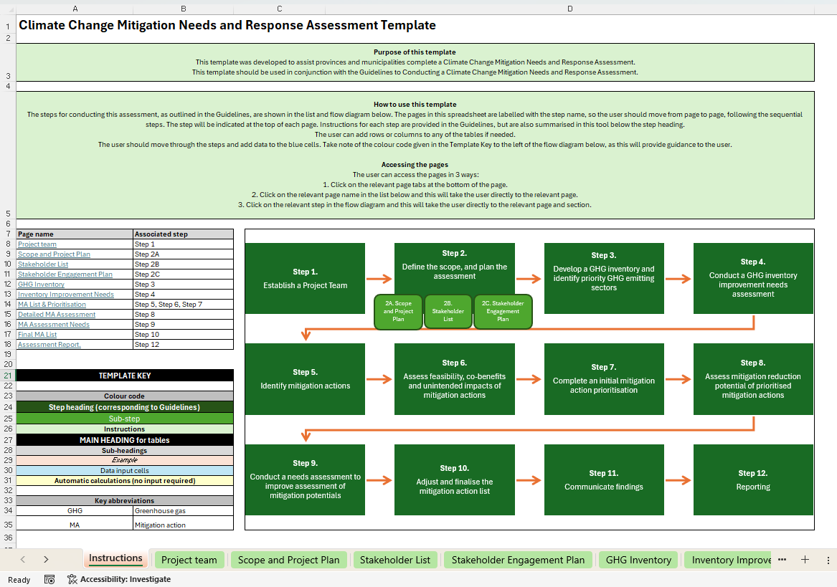
Guidelines for Conducting a Climate Change Mitigation Needs and Response Assessment
Provides:
  Step-by-step guidance on completing a climate change mitigation needs and response assessment.
  Includes flexibility in the approach as it allows for a basic or an advanced assessment, with the advanced incorporating more detail.
  An Excel tool to assist in the process. Tool has a worksheet for each step and allows input of data and text, supporting compilation of the assessment report.
  The guidance document provides information on where to link to the tool and how to complete it.
  Highlights the importance of stakeholder engagement.

Slide 27
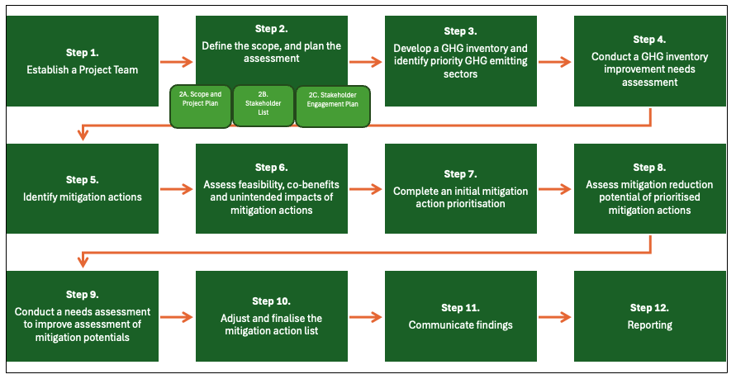
CCMNRA: Overview

Slide 28
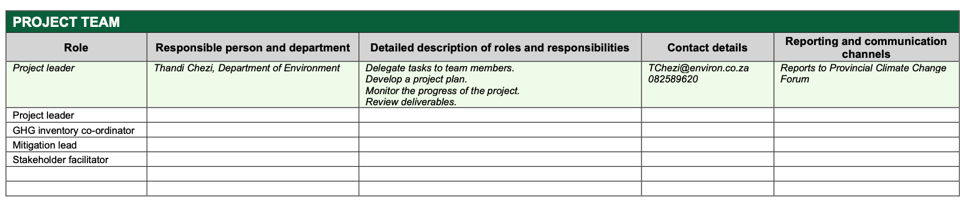
Step 1: Establish a project team
Helps to ensure accountability
May be just one or two people, or a broader team if an advanced assessment is being conducted

Slide 29
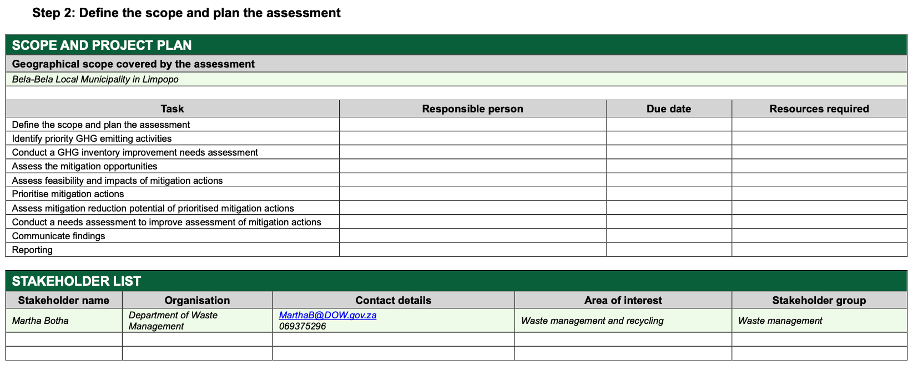
Step 2: Define the scope and plan the assessment, including stakeholder plan

Slide 30
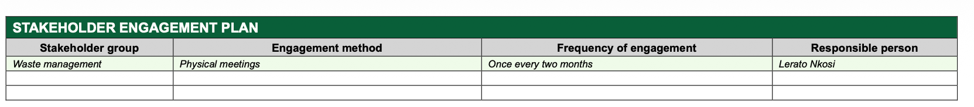
Step 2: Define the scope and plan the assessment, including stakeholder plan

Slide 31
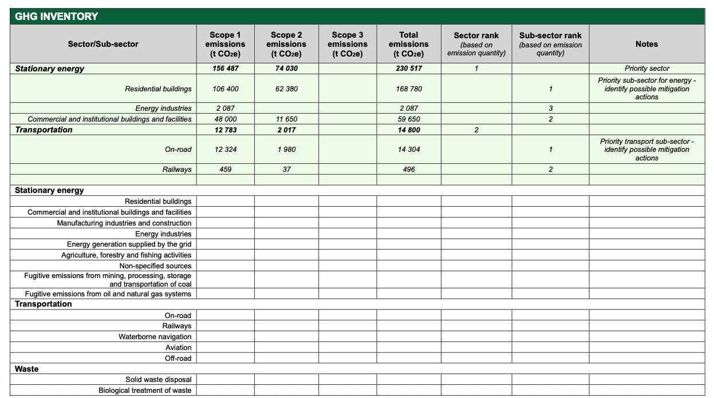
Step 3: Develop a GHG inventory and identify priority GHG emitting sectors

Slide 32
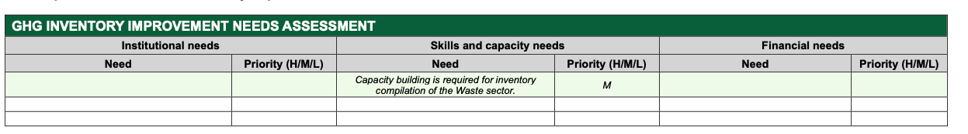
STEP 4: CONDUCT A GHG INVENTORY IMPROVEMENT NEEDS ASSESSMENT

Slide 33
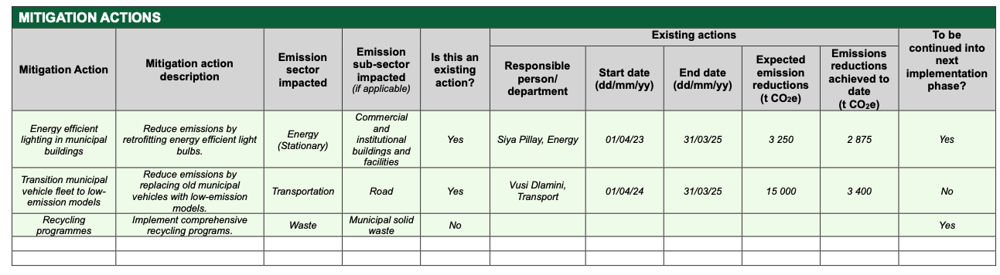
Step 5: Identify mitigation actions

Slide 34
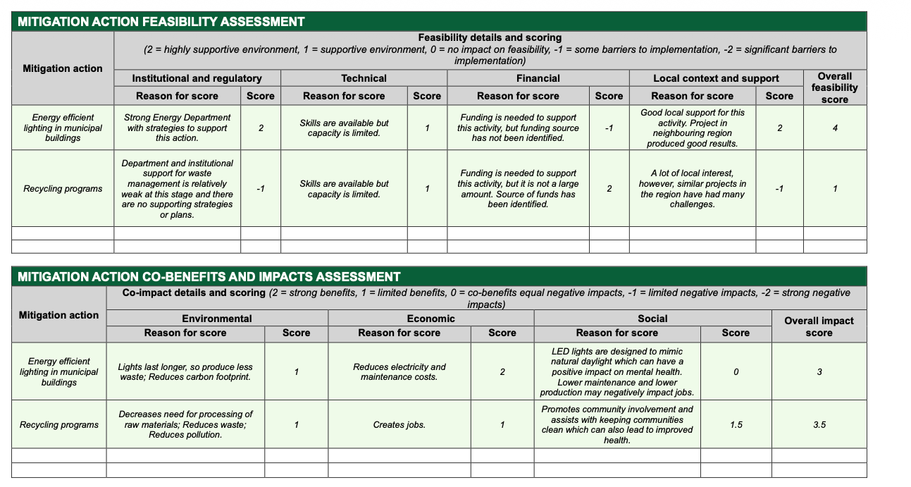
Step 6: Assess feasibility, co-benefits and impacts of additional mitigation actions

Slide 35
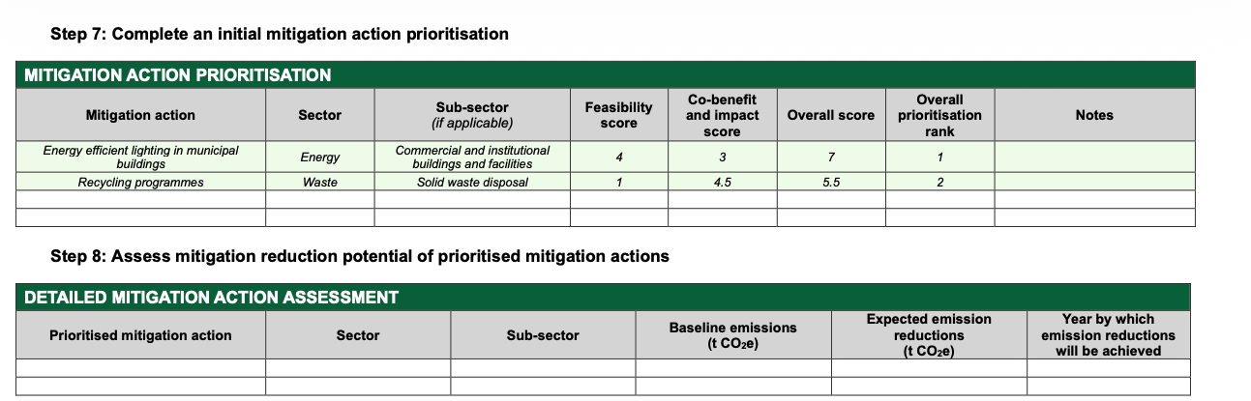
Step 7: Complete an initial mitigation action prioritisation
Step 8: Assess mitigation reduction potential of prioritised mitigation actions

Slide 36
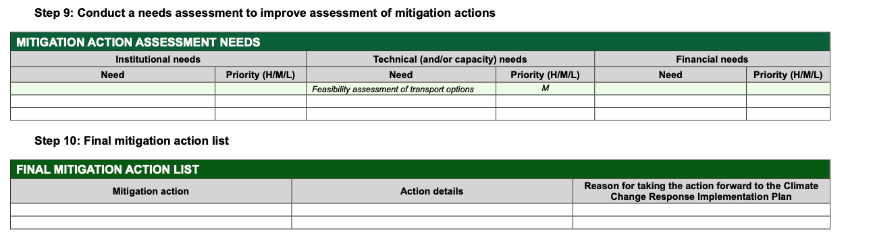
Step 9: Conduct a needs assessment to improve assessment of mitigation actions
Step 10: Final mitigation action list

Slide 37
Step 11: Communicate the findings
Effectively communicating CCNRA requires clear, accessible, and context-sensitive messaging that empowers the community and invites them into the conversation.
Ensure that community understand the impacts of increasing emissions and climate change, and feel empowered to act reduce emissions:
  Using simple and clear language.
  Engaging through multiple channels (community meetings, visual materials, local media).
  Making information accessible by considering literacy levels, languages and educational backgrounds.
  Highlighting mitigation opportunities that are relevant to the community.
  Allowing for open dialogue.
  Utilising communication styles and content aligned with community cultural practices and values.
  Highlighting how climate mitigation can be integrated into their daily activities.

Slide 38
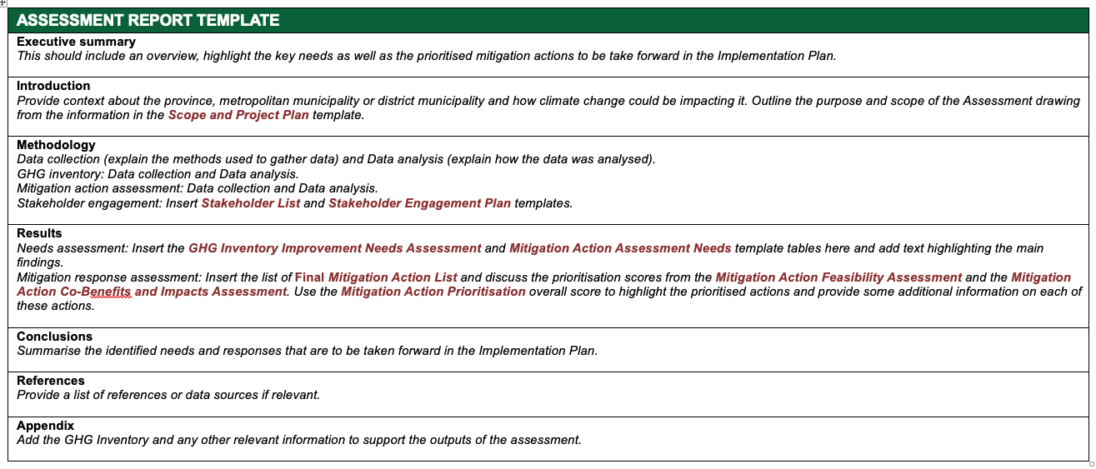
STEP 12: REPORTING

Slide 39
Exercise

Slide 40
CCNRA
Group into teams of 3 or 4
Go through the written handout step by step
Discuss your responses and fill them in on the spreadsheet tool
Work through the reporting template to understand how you would compile the responses
Group feedback:
  How did you find working through the exercise?
  What did you find challenging?
  Do you think it asks for too much information?
  Feedback for improvements?

Slide 41
5
Climate change mitigation implementation plan (CCMIP)

Slide 42
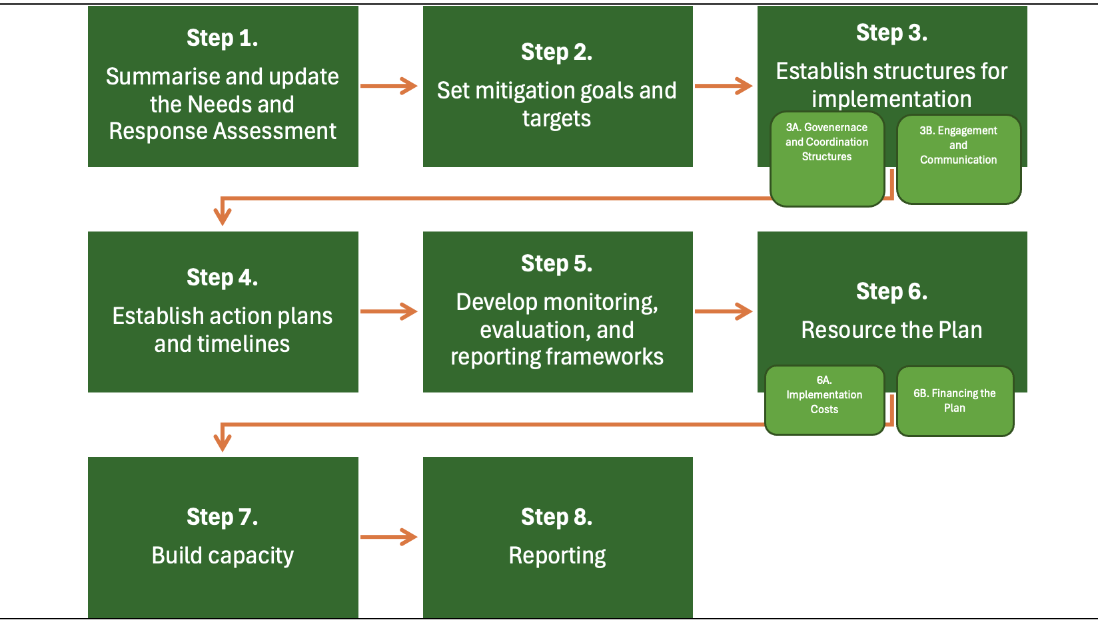
CCMNRA: Overview

Slide 43
6
Stakeholder engagement guidance

Slide 44
STAKEHOLDER ENGAGEMENT GUIDELINE TRAINING
Delivered with support from UK PACT (Partnering for Accelerated Climate Transitions)

Slide 45
1
Purpose, Scope and Legal Basis
The CCA places climate action (adaptation and mitigation) as the shared responsibility of national, provincial and local government.
Mitigation decisions shape energy, transport, land use and livelihoods, so this guideline exists to help officials apply the Act's engagement obligations in practice.
Intended users: municipal and provincial climate officials, Municipal and Provincial Climate Change Forum secretariats, civil society, traditional leadership and private sector partners.
Section 1 · Purpose, Scope and Legal Basis
Stakeholder Engagement Guideline · CCA 22 of 2024

Slide 46
Legal Basis, Compliance and Guiding Principles
Legislative Mandate: Stakeholder engagement is a statutory obligation under the CCA, not a ‘nice to have’:
S3 (Guiding Principle); S7(institutional alignment); Ss 8 & 9 (Provincial & Muni CC Forums); Ss 17- 19 (Provincial & Muni Climate response – deferred- focus on disaggregated vulnerability); s20 (National adaptation strategy- local knowledge); Chap 6 (Consultation: S31; Public Participation; S32 )
Beyond the CCA: engagement obligations also flow from the Municipal Systems Act (IDP participation), the IGR Framework Act, PAJA, and South Africa's GEDSI legal architecture (Employment Equity Act, CEDAW, CRPD).
Who Must Comply: the responsibility sits with the ‘organ of state’ responsible for the decision
Note: outsourcing engagement to consultants does not transfer accountability.
GEDSI Guiding Principles:
  equity of voice is not equality of invitation;
  demonstration matters more than declaration;
  robust engagement cannot be a precondition for all action.
Section 1 · Legal Basis
Stakeholder Engagement Guideline · CCA 22 of 2024

Slide 47
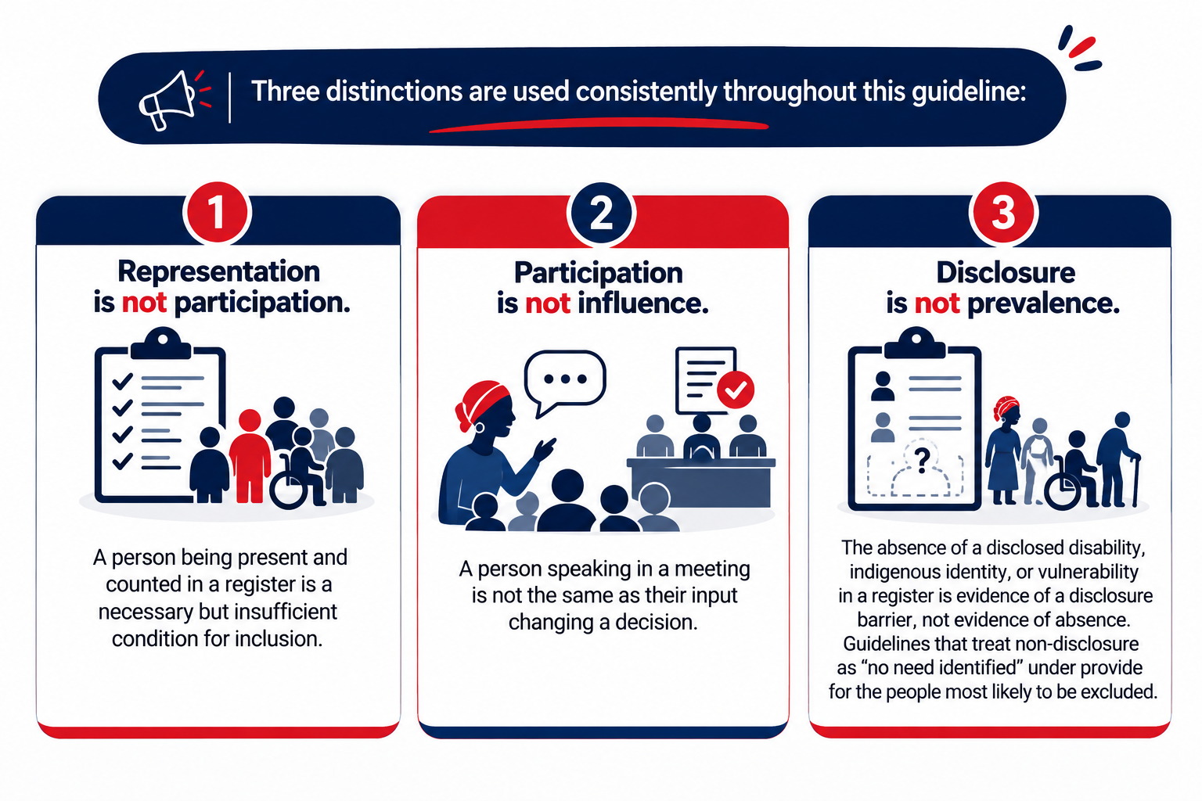
Figure 1: Three Key Distinctions
Section 1
Stakeholder Engagement Guideline · CCA 22 of 2024

Slide 48
2
Identifying Stakeholders
Stakeholders are frequently collapsed into a single group. The guideline distinguishes three categories, each entering the engagement process through a different pathway.
Rights holders
Duty bearers
Knowledge holders
Directly affected: participate because they are affected, not because of formal identity.
Organs of state with a legal obligation: owe transparency to rights holders.
Participate based on what they know; inform, never substitute for, rights holder voice.
Section 2 · Identifying Stakeholders
Stakeholder Engagement Guideline · CCA 22 of 2024

Slide 49
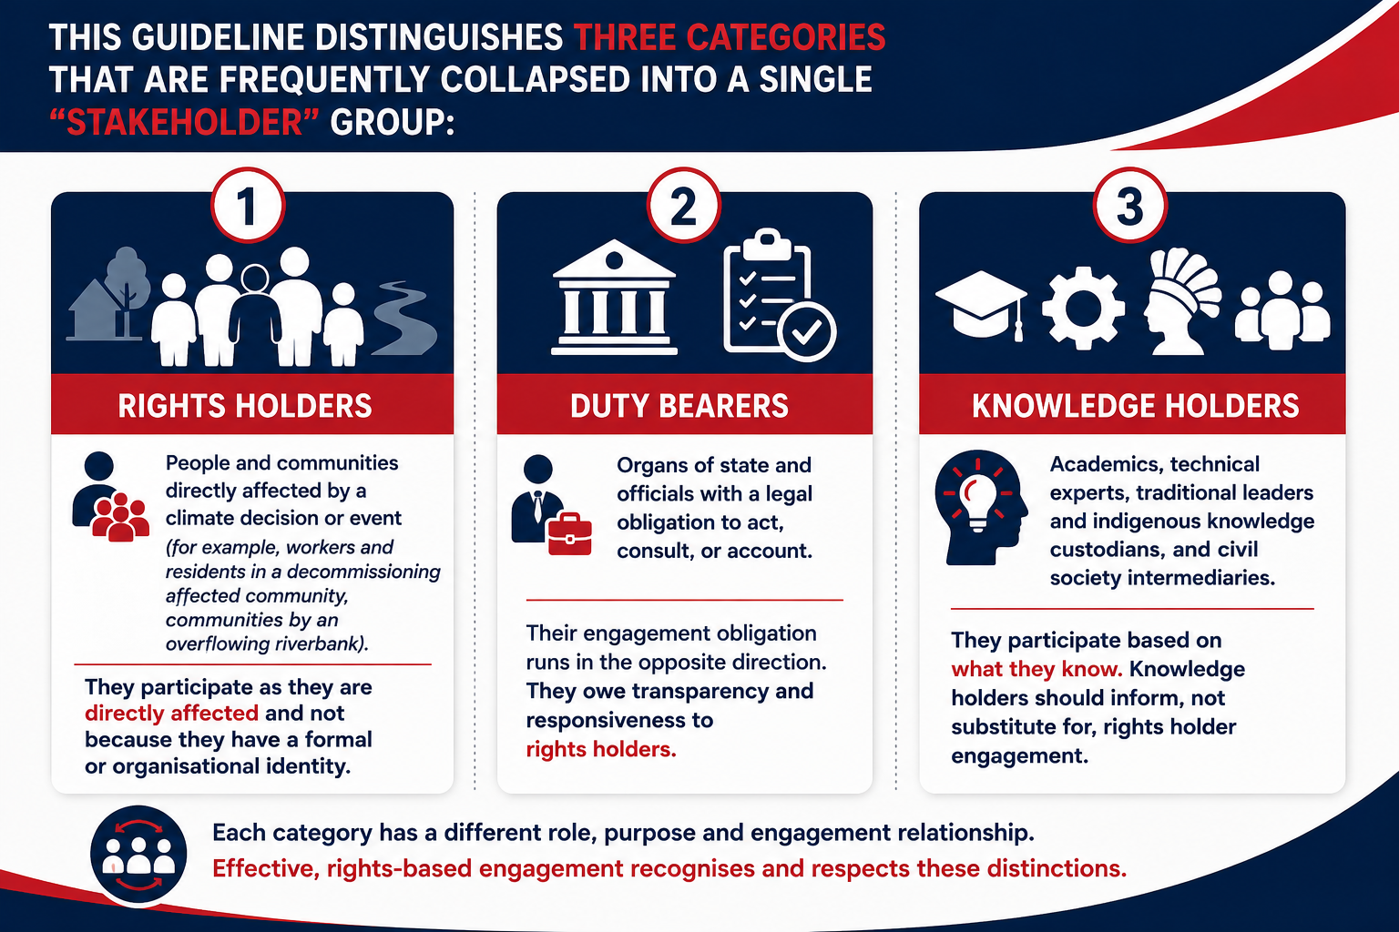
Figure 2: Stakeholder Categories
Section 2.1
Stakeholder Engagement Guideline · CCA 22 of 2024

Slide 50
Stakeholder Identification in Practice
Stakeholder Categories by CCA Function: categorising by function reveals the specific exclusion barriers each stakeholder group is likely to face
Stakeholder Mapping Matrix: every engagement should begin with a completed mapping matrix : stakeholder, category, impact level, capacity constraints, GEDSI factors, recommended tier.
Municipal Register: extend the existing IDP stakeholder database and ward committee structures with CCA-specific fields, rather than building a parallel database from scratch.
Governance: treat the register as a living document, reviewed before each Forum cycle and annually at minimum.
Note: GEDSI fields are special personal information under POPIA (consent must be explicit and purpose-limited).
Structurally Excluded Groups: mapping is only the start . Hard to reach groups (e.g. persons with disabilities) require additional accommodations to move from participation to meaningful inclusion.
Section 2 · Stakeholder Identification in Pratice
Stakeholder Engagement Guideline · CCA 22 of 2024

Slide 51
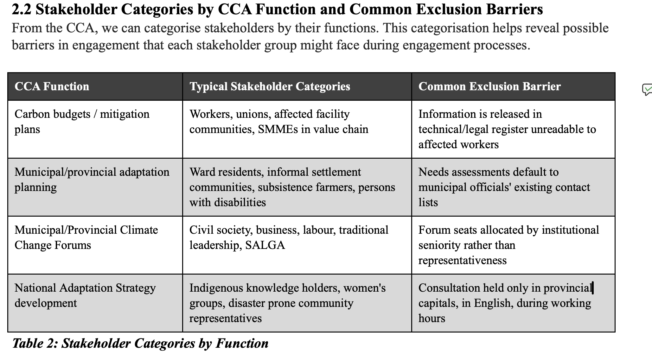
Stakeholder Categories
Section 2 · Stakeholder Identification in Pratice
Stakeholder Engagement Guideline · CCA 22 of 2024

Slide 52
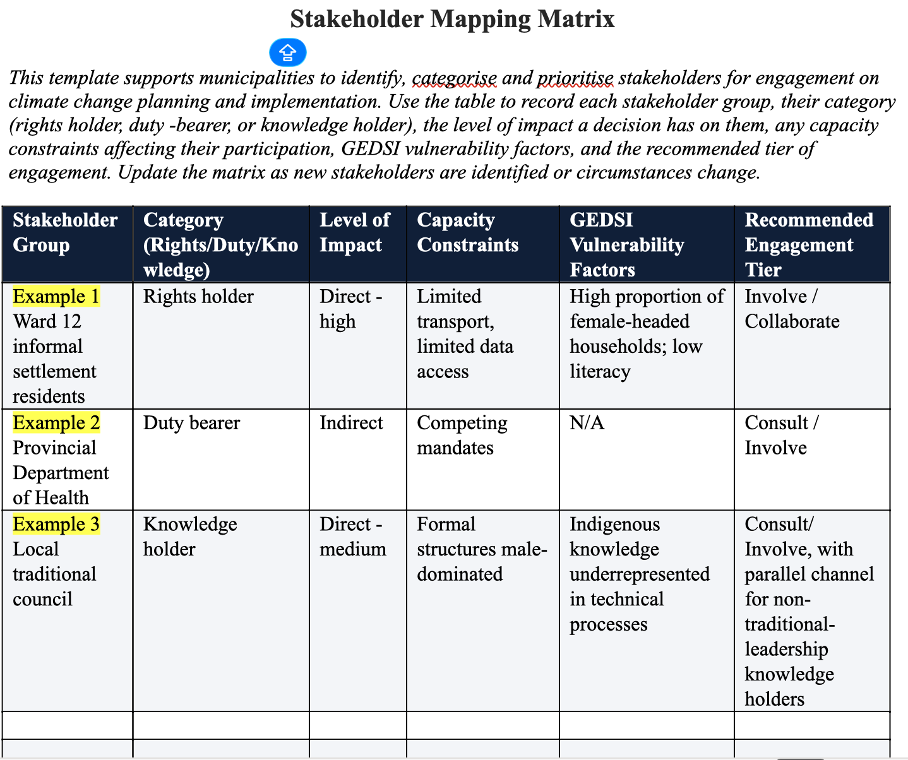
Stakeholder Matrix Template
Section 2 · Stakeholder Identification in Pratice
Stakeholder Engagement Guideline · CCA 22 of 2024

Slide 53
3
Designing and Running Engagements
3.1 Tiered Engagement Model: this guideline adopts a five-tier approach:
Inform → Consult → Involve → Collaborate → Empower
Statutory Forums under ss.8 and 9 of the CCA should operate at Collaborate, at minimum, with a deliberate effort to progress beyond a mere ‘Inform’ benchmark over time.
Section 3 · Designing and Running Engagements
Stakeholder Engagement Guideline · CCA 22 of 2024

Slide 54
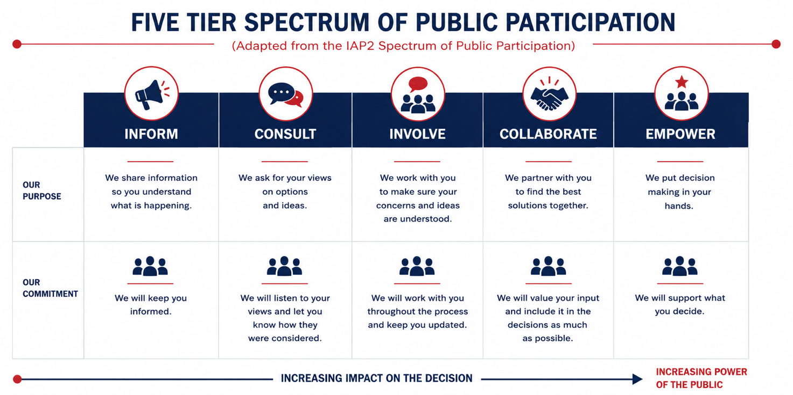
Figure 3: Five Tier Engagement Model
Section 3.1
Stakeholder Engagement Guideline · CCA 22 of 2024

Slide 55
Design Engagement Around the People in the Room
• Choose methods according to stakeholder category, connectivity, literacy, location and power dynamics; mixed methods may be necessary.
• Link community level structures formally to Municipal Climate Change Forums so issues can move upward and feedback can return downward.
• Provide materials in relevant local languages and plain language formats alongside technical documents.
• Budget interpretation, accessible formats, transport, assistive technology and care considerations as standard engagement costs.
• Use at least two weeks’ notice for community level engagement where circumstances permit.
Part C — Designing & Running Engagement

Slide 56
Method, Structure and Accessibility
Engagement Method Selection Matrix: there is no one-size-fits-all approach. The right model is largely determined by who is in the room; mixed methods are often most appropriate.
Community Level Structures: ward based climate change committees should be formally linked to the statutory Municipal Climate Change Forum, with a clear upward/downward feedback pathway. Without this link they risk becoming a ‘talking shop’.
Minimum Accessibility Standards, including:
Materials in dominant local languages, not English only; plain language summaries alongside technical documents.
Sign language interpretation as standard, not only on request; digital materials tested for low-bandwidth and screen-reader access.
Minimum two weeks' notice; transport costs and care responsibility timing budgeted as standard line items.
Section 3 · Method, Structure and Accessibility
Stakeholder Engagement Guideline · CCA 22 of 2024

Slide 57
4
GEDSI Representation
GEDSI is used in its full technical sense, not shorthand for ‘women and youth’.
It requires attention to gender (incl. non-binary identities), disability across all domains, age, socio-economic status, geographic remoteness and indigenous identity.
Compounding effect of holding more than one of these identities at once
Grounded in ss.9 & 24 of the Constitution, the Employment Equity Act, the White Paper on the Rights of Persons with Disabilities, CEDAW and the CRPD.
Section 4 · GEDSI Representation
Stakeholder Engagement Guideline · CCA 22 of 2024

Slide 58
Disaggregated Data & Participation Thresholds
Minimum registration fields: gender (incl. non-binary, prefer not to say); age band aligned to census/IDP data; disability (self-identification via functional questions); sector, settlement type, language and format preference.
Participation Thresholds: the CCA creates no legal basis for quotas. Guideline recommends target ranges, read together with influence tracking so presence targets don't become ‘inclusion theatre’:
No single gender category should ideally exceed ~60% of voting/decision shaping seats without documented justification.
At least one seat for youth, persons with disabilities, and women in a senior/decision-making capacity in each Forum.
Traditional leadership representation paired with a parallel channel for indigenous knowledge holders outside formal structures.
Section 4 · Data & Thresholds
Stakeholder Engagement Guideline · CCA 22 of 2024

Slide 59
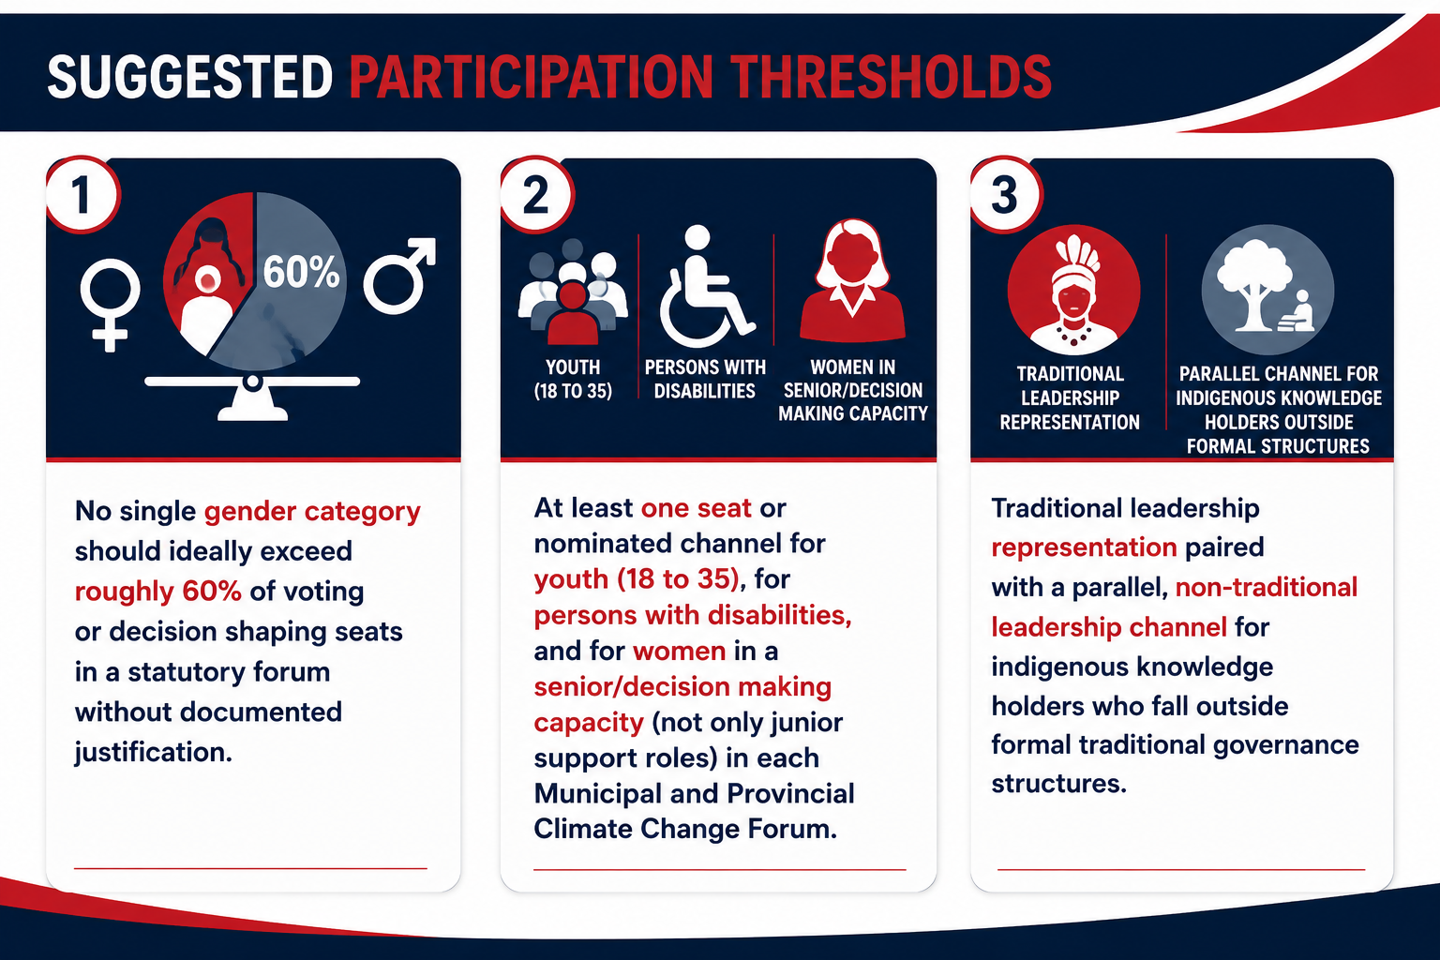
Figure 4: Suggested Participation Thresholds
Section 4.3
Stakeholder Engagement Guideline · CCA 22 of 2024

Slide 60
Accessibility and Intersectional Barriers
Four Accessibility Domains: Physical, Communication, Programmatic, Attitudinal – to be kept in mind before, during and after every engagement.
4.5 Cross tabulate GEDSI variables (e.g. age by sector) rather than reporting them in isolation: the most actionable findings emerge at the intersection.
  UK PACT-funded provincial monitoring data: in KwaZulu-Natal, young women (18 to 35) were the largest group at municipal/provincial level, yet senior female representation thinned sharply above 50. In Mpumalanga, the pattern reversed mid-career women dominated overall attendance, but national seats and the senior 51 to 70 bracket were disproportionately male. Aggregate gender balance concealed a real seniority and power imbalance until the intersectional layer was applied.
Section 4 · Accessibility & Intersectionality
Stakeholder Engagement Guideline · CCA 22 of 2024

Slide 61
5
Indigenous and Local Knowledge Integration
Recognising Indigenous Knowledge as Evidence:
Discussions on climate priorities tend to centre scientific knowledge, sidelining the lived realities it is rooted in.
Indigenous and local knowledge (of seasonal patterns, land and water management, disaster response and ecological change over generations) must be documented and weighed in climate programmes and policy as parallel to, not illustrative of, scientific knowledge.
Section 5 · Indigenous and Local Knowledge
Stakeholder Engagement Guideline · CCA 22 of 2024

Slide 62
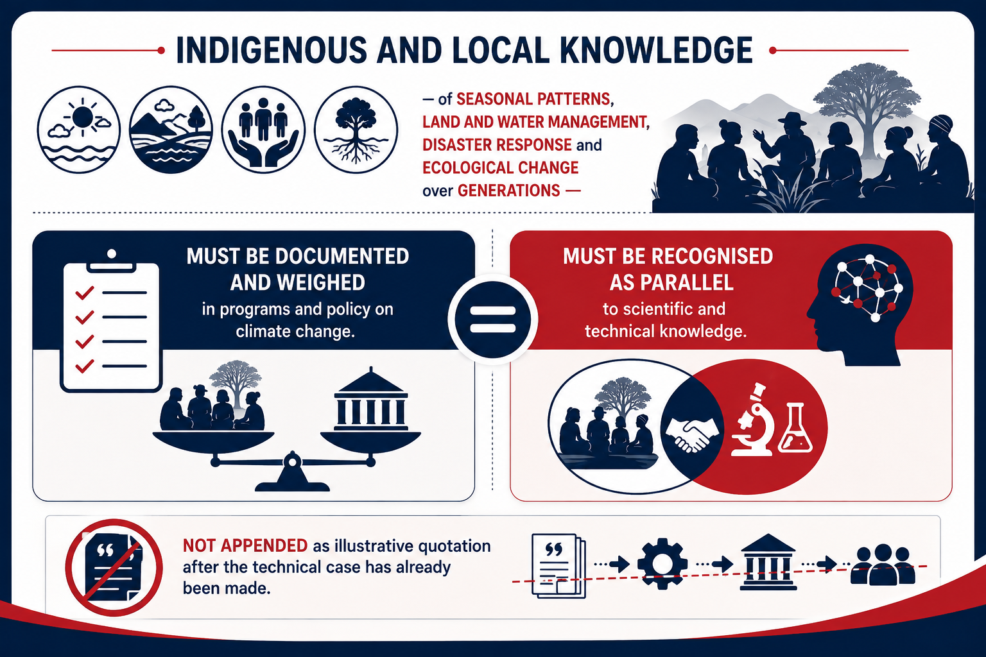
Figure 5: Indigenous Knowledge Parallel to Scientific Knowledge
Section 5.1
Stakeholder Engagement Guideline · CCA 22 of 2024

Slide 63
Protocols and Safeguards
Two complementary channels are required:
  traditional leadership structures (the recognised governance interface, but predominantly male) and;
  a parallel channel reaching women elders, subsistence farmers and healers outside formal structures.
Indigenous knowledge should be formally solicited at three points:
  municipal/provincial needs assessments,
  National Adaptation Strategy scenario development, and
  post-event review of disaster/extreme weather response.
5.3 Safeguards: free, prior and informed consent (FPIC); attribution to the community or individual, not anonymised into generic ‘stakeholder input’; guard against extractive research fatigue from repeat solicitation.
Section 5 · Protocols and Safeguards
Stakeholder Engagement Guideline · CCA 22 of 2024

Slide 64
6
Timing of Engagement across the CCA Cycle
Engagement Touchpoints: engagements are mapped to specific statutory obligations, not left to happen in a vacuum, tailored to when engagement should occur, who should be involved, and what form it should take at each stage of the CCA cycle.
Municipal Annual Engagement Calendar: publish forum dates, IDP comment windows and community engagement rounds.
Cross-checked against school terms, harvest seasons, religious observances and grant payment dates.
Section 6 · Timing
Stakeholder Engagement Guideline · CCA 22 of 2024

Slide 65
Fast Track Protocol for Urgent Decisions
Emergency and disaster linked climate decisions cannot always accommodate standard notice periods. But compressed timelines are exactly where inclusion safeguards are most likely to be dropped first.
This guideline suggests a non-negotiable inclusion floor that applies even under fast track conditions:
Communication in the dominant local language(s), at minimum.
A nominated accessible channel for persons with disabilities.
A post-hoc feedback session once the emergency has passed, to capture concerns compressed timing could not accommodate.
Section 6 · Fast Track Protocol
Stakeholder Engagement Guideline · CCA 22 of 2024

Slide 66
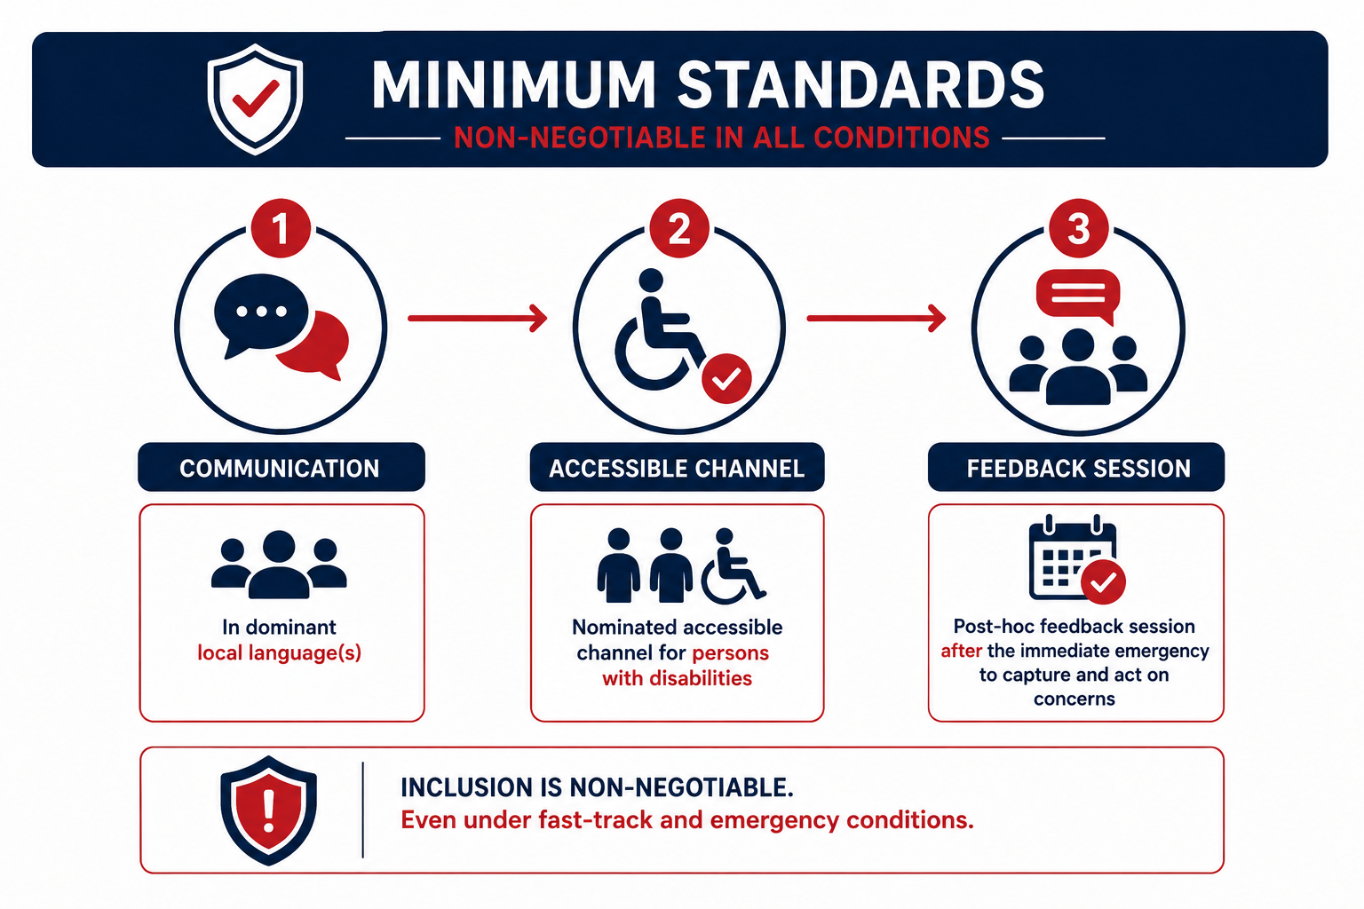
Figure 6: Minimum Standards for Urgent Engagements
Section 6.3
Stakeholder Engagement Guideline · CCA 22 of 2024

Slide 67
7
Closing the Loop
What differentiates stakeholder participation as a tick box exercise from participation that reflects real influence, is what happens to the input afterward.
Input must be logged and disaggregated by GEDSI category at the point of capture- not aggregated into a generic ‘stakeholders raised concerns about…’ summary.
“You Said, We Did”: engagement outcomes must be traceably linked to amendments in the IDP, climate response implementation plan and provincial EIP, with version controlled records.
Section 7 · Closing the Loop
Stakeholder Engagement Guideline · CCA 22 of 2024

Slide 68
Escalation Pathway for Unresolved Contestation
Not all input can or should be adopted.
Contestation that cannot be resolved at the point of engagement should be escalated through a defined pathway, with a documented record at each level of why the matter moved upward and what remains unresolved.
Suppressing unresolved contestation, rather than escalating it transparently, is what generates opposition later and erodes trust in the engagement process.
Section 7 · Escalation Pathway
Stakeholder Engagement Guideline · CCA 22 of 2024

Slide 69
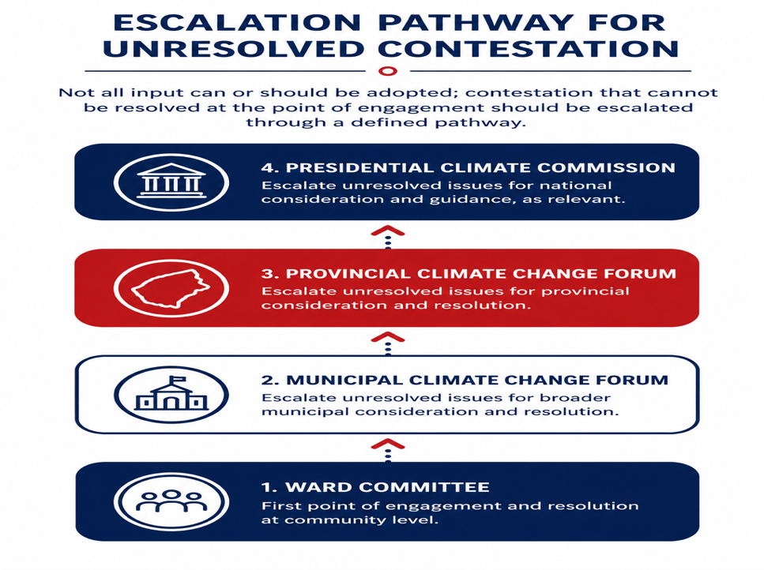
Figure 7: Escalation Pathway for Unresolved Contestation
Section 7.3
Stakeholder Engagement Guideline · CCA 22 of 2024

Slide 70
Monitoring, Evaluation and Learning Indicators
Reporting must track process and outcome indicators together, not process indicators alone — tracking is also a learning opportunity toward the overarching goal of empowering stakeholders.
Process indicators:
Composition of attendance by GEDSI category; survey feedback tracking input and understanding; accessibility provisions delivered against those planned.
Outcome indicators:
Proportion of documented GEDSI-tagged concerns reflected in a final decision (the ‘voice-to-influence ratio’); time elapsed between input received and feedback communicated.
Section 7 · M&E Indicators
Stakeholder Engagement Guideline · CCA 22 of 2024

Slide 71
8
Institutional Roles and Responsibilities
Meaningful engagement cannot depend solely on individual officials' commitment
It must be embedded in the institutional arrangements through which the CCA is implemented.
Roles are shared but not interchangeable.
Municipalities
Mayors hold ultimate accountability under ss.17 - 19. A named GEDSI & Engagement Focal official maintains the register and compiles the voice-to-influence report.
Provinces
MECs and the Provincial Forum secretariat hold equivalent responsibility, plus a quality-assurance role - flagging municipalities where indicators stagnate or decline.
SALGA, Districts & Traditional Councils
SALGA coordinates shared training and database standards; districts support under-resourced municipalities; traditional councils engage via the dual-channel protocol.
Section 8 · Roles and Capacity
Stakeholder Engagement Guideline · CCA 22 of 2024

Slide 72
Conclusion
At its core SE rests on a simple proposition: representation is not participation, and participation is not influence. A well attended meeting demonstrates reach not, on its own, meaningful engagement.
GEDSI is designed in from the start: identifying who may be missing as carefully as who is present; recognising indigenous and local knowledge alongside scientific knowledge; providing accessible routes into engagement; and creating a clear decision trail from stakeholder voice to institutional action.
Not every contribution will change a decision — what matters is that contributions are heard, accounted for, and where they cannot be incorporated, there is transparency about why.
Section 8 · Conclusion
Stakeholder Engagement Guideline · CCA 22 of 2024

Slide 73
VOICE TO INFLUENCE
A Mock Municipal Climate Change Forum Exercise
Representation ≠ Participation ≠ Influence

Slide 74
What are we testing?
WHY THIS EXERCISE
1
BE IN THE ROOM
2
BE HEARD
3
SHAPE THE DECISION
Does presence automatically mean that your priorities shape the outcome?
Does having a chance to speak mean that your contribution carries equal weight?
Whose ideas actually make it onto the final decision sheet and why?
VOICE TO INFLUENCE • MOCK MUNICIPAL CLIMATE CHANGE FORUM

Slide 75
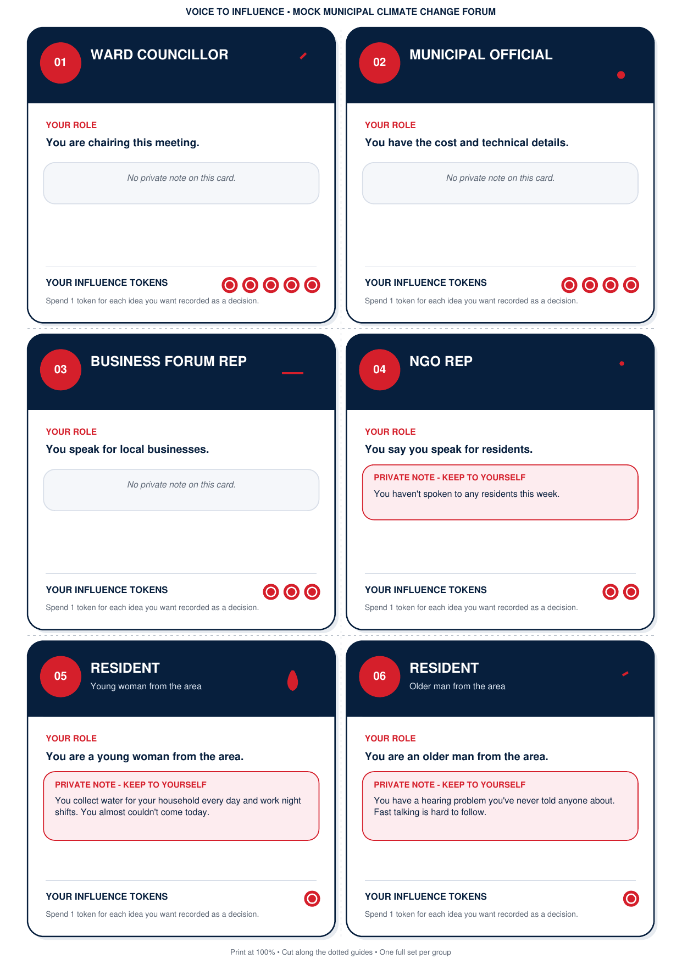
Set up your Mock Forum
BEFORE WE BEGIN
• Work in groups of 5 to 6 people.
• Each participant receives one role card, face down. Read only your own card. If you have an instruction in red on your card, do NOT disclose to anyone.
• Each role comes with a different number of influence tokens.
• Choose one person in your group to record every idea that successfully makes it into the group decision.
VOICE TO INFLUENCE • MOCK MUNICIPAL CLIMATE CHANGE FORUM

Slide 76
The six roles
KEEP PRIVATE NOTES PRIVATE
1
Ward Councillor
2
Municipal Official
3
Business Forum Rep
5 influence tokens
4 influence tokens
3 influence tokens
4
NGO Rep
5
Resident: young woman
6
Resident: older man
2 influence tokens
1 influence token
1 influence token
VOICE TO INFLUENCE • MOCK MUNICIPAL CLIMATE CHANGE FORUM

Slide 77
THE ONE RULE
If you want your idea written down as part of the decision, you must spend ONE token.
Once a token is spent, it is gone.
NO EXPLANATION YET • JUST PLAY THE RULE

Slide 78
The agenda item: Street Lights Upgrade
25 MINUTES
The municipality has funding for the first phase of a streetlights upgrade. Only about 20% of your municipality will receive new lights.
AS A GROUP, YOU ARE TO DECIDE:
Where should the new lights go first? (E.G TAXI RANK AREA, RESIDENTIAL AREA IN NEED, TOWNSHIP..)
Should any conditions be attached - for example, asking residents where they think the lights are needed most?
VOICE TO INFLUENCE • MOCK MUNICIPAL CLIMATE CHANGE FORUM

Slide 79
Forum in session
DISCUSS • SPEND • RECORD
1
1 • DISCUSS
2
2 • SPEND
3
3 • RECORD
Stay in role. Make the case you think your character would make.
Spend one token whenever you want an idea formally captured.
The recorder writes down every idea backed by a token. Those ideas become your decision trail.
VOICE TO INFLUENCE • MOCK MUNICIPAL CLIMATE CHANGE FORUM

Slide 80
Report back
WHAT DID YOUR FORUM DECIDE?
• Read out your final decision(s).
• Show the room the ideas that made it onto your decision sheet.
• Do not reveal the private lines on your role cards yet.
WHOSE IDEAS
MADE IT
ONTO THE
SHEET?
VOICE TO INFLUENCE • MOCK MUNICIPAL CLIMATE CHANGE FORUM

Slide 81
Now flip the cards
THE REVEAL
• Who ran out of tokens or never spent any?
• What were the private lines on the role cards?
• Did anyone notice those circumstances during the discussion?
• Did the number of tokens affect whose knowledge was treated as decision relevant?
VOICE TO INFLUENCE • MOCK MUNICIPAL CLIMATE CHANGE FORUM

Slide 82
From voice to influence
DEBRIEF
REPRESENTATION
PARTICIPATION
INFLUENCE
Who was present? Who was missing?
Who could speak, follow the discussion and participate meaningfully?
Whose input changed or shaped the final decision?
VOICE TO INFLUENCE • MOCK MUNICIPAL CLIMATE CHANGE FORUM

Slide 83
THE TAKEAWAY
Being invited into the room is not the same as being able to shape the decision.
Good engagement must deliberately create a pathway from voice → consideration → influence.

Slide 84
brett@thinka.co.za (Brett Cohen)
luanne@jacali.net (Luanne Stevens)
flmoni85@gmail.com (Funmilola Oni-Adeniyi)
elanie@caelus.co.za (Elanie Van Staden)

